Slide 1


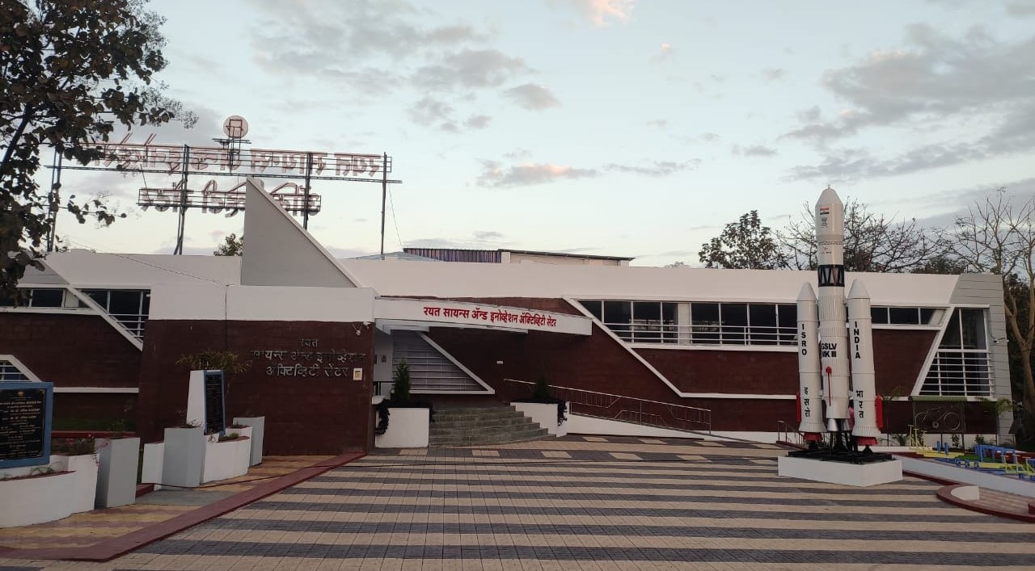
RAYAT SHIKSHAN SANSTHA, SATARA
RAYAT SCIENCE AND INNOVATION
ACTIVITY, CENTRE, VARYE, SATARA
WELCOME
Annual meet of mentors of science and innovation activity centers at pravaranagar 24th & 25th April 2025

Slide 2
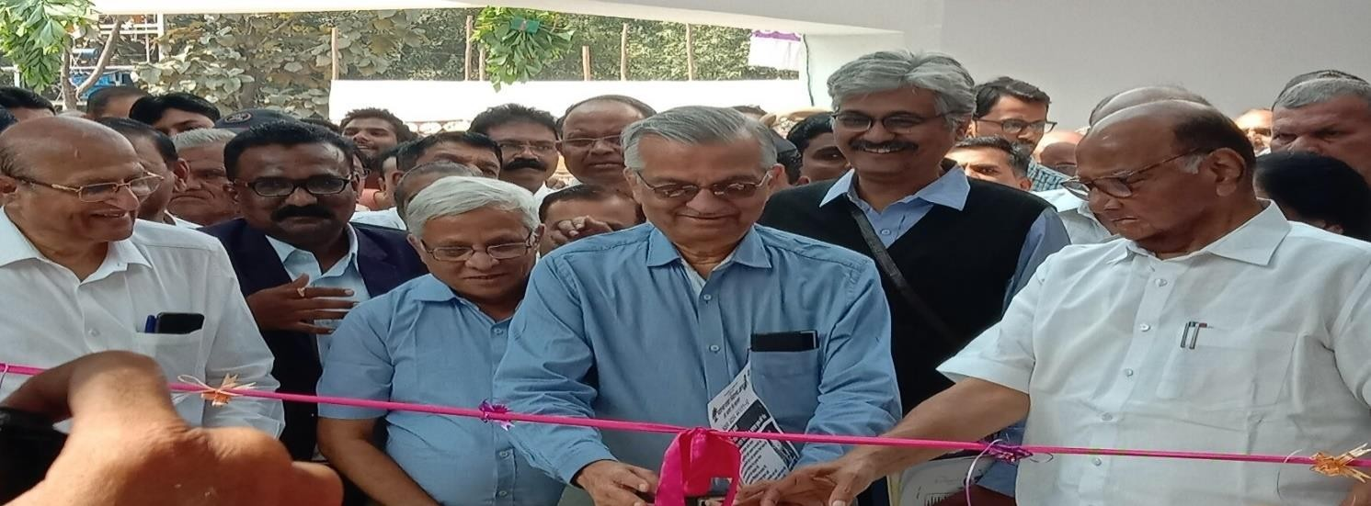
Introduction to RSIAC
Building foundation : 15 March 2017.
Inauguration : 14 February 2020.
Land Allotment: One Hecter
Building Area of 550 square meters.
Power: Solar Power 20 kw.
Water: Borewell
Organizations Association
Rayat Shikshan Sanstha, Satara
Rajeev Gandhi Science and Technology Commission, Government of Maharashtra, Mumbai.
Neharu Science Center, Mumbai.
Homi Bhabha Science Center, Mumbai
Hon’ble Dr. Anil Kakodkar and Hon’ble Sharadchandraji Pawar

Slide 3
Administrative Body
Sr. | Name of the Member | Designation
1 | Hon’ble. Shri. Vikas Krushnaji Deshmukh ,IAS(Retd.) Secretary, Rayat Shikhan Sanstha, Satara | President
2 | Hon’ble. Principal Dr. Shivling Gangadhar Menkudale, Joint Secretary (H.E.), Rayat Shikhan Sanstha, Satara | Vice President
3 | Hon’ble. Shri. Bandu Narayan Pawar Joint Secretary (S.E.), Rayat Shikhan Sanstha, Satara | Vice President
4 | Hon’ble. Shri. Sanjiv Jaykumar Patil, Regional Chairmen, Central Region, Rayat Shikhan Sanstha, Satara | Member
5 | Hon’ble. Shri. Navnath Ramchandra Jagdale, Regional Inspector, Central Region, Rayat Shikhan Sanstha, Satara | Member
6 | Hon’ble. Shri. Shrikant Kunden , CEO, CIII, Satara | Member
7 | Hon’ble. Dr. Bharat T. Jadhav, Principal, YCIS , Satara | Member
8 | Hon’ble. Dr. Sudhir Kumbhar, Retired Teacher | Coordinator
9 | Hon’ble. Shri. Anil Govind Potdar, Retired Head Master | Member
10 | Hon’ble. Shri. Anand Shantaram Aalekari , Teacher, D.P. Bhosale College, Koregaon | Member
11 | Hon’ble. Shri. Vishal Vijay Lad, Jr.,Teacher , Wagheshwar | Member
12 | Dr. Sarang Shankar Bhola. | Member Secretary

Slide 4
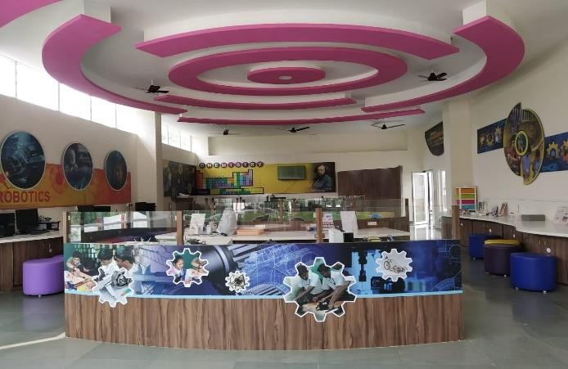
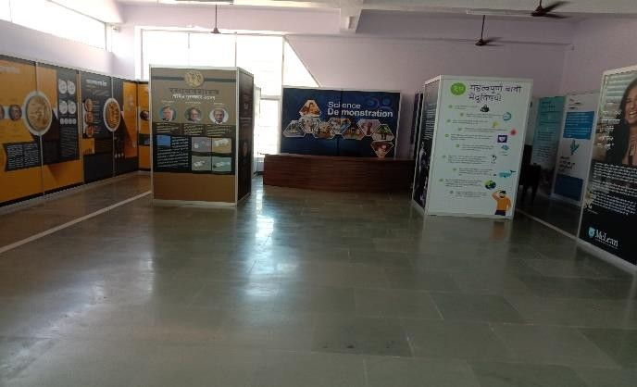
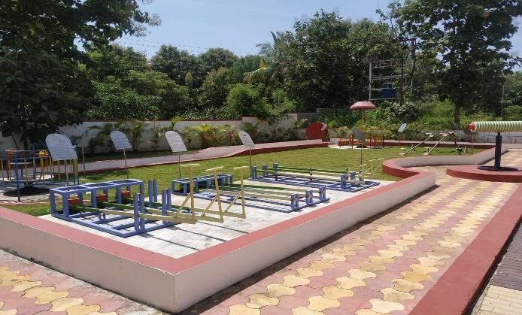
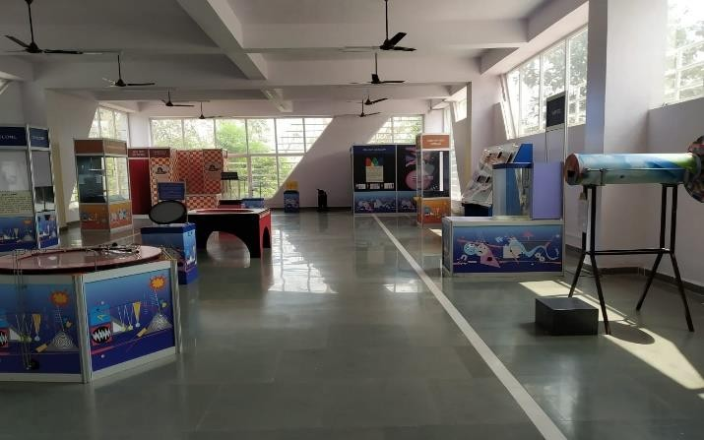
Existing Galleries at RSIAC
Exhibition Hall
Innovation Hub
Science Park
Fun Science Hall

Slide 5
Present Scenario
Total 30 Exhibits Present : ( Indoor -19 , Outdoor – 11)
Numerical Record: Visit from 14 February 2020 to 31 March 2025.
So far 95 schools, 45 Colleges have visited to the science center so far.
Sr. | Year | Total Count
1 | 14th February 2020 to 20th March 2020 | 720
2 | 1st April 2020 to 31st March 2021(Online) | 250
3 | 15th April 2021 to 31st March 2022 | 4400
4 | 1st April 2022 to 31st March 2023 | 7676
5 | 1st April 2023 to 31st March 2024 | 5305
6 | 1st April 2024 to 31st March 2025 Visits | 6541
 | 1st April 2024 to 31st March 2025 Outreach Activities and Extra Activities (4883+1791) | 6674
 | Total | 31566

Slide 6
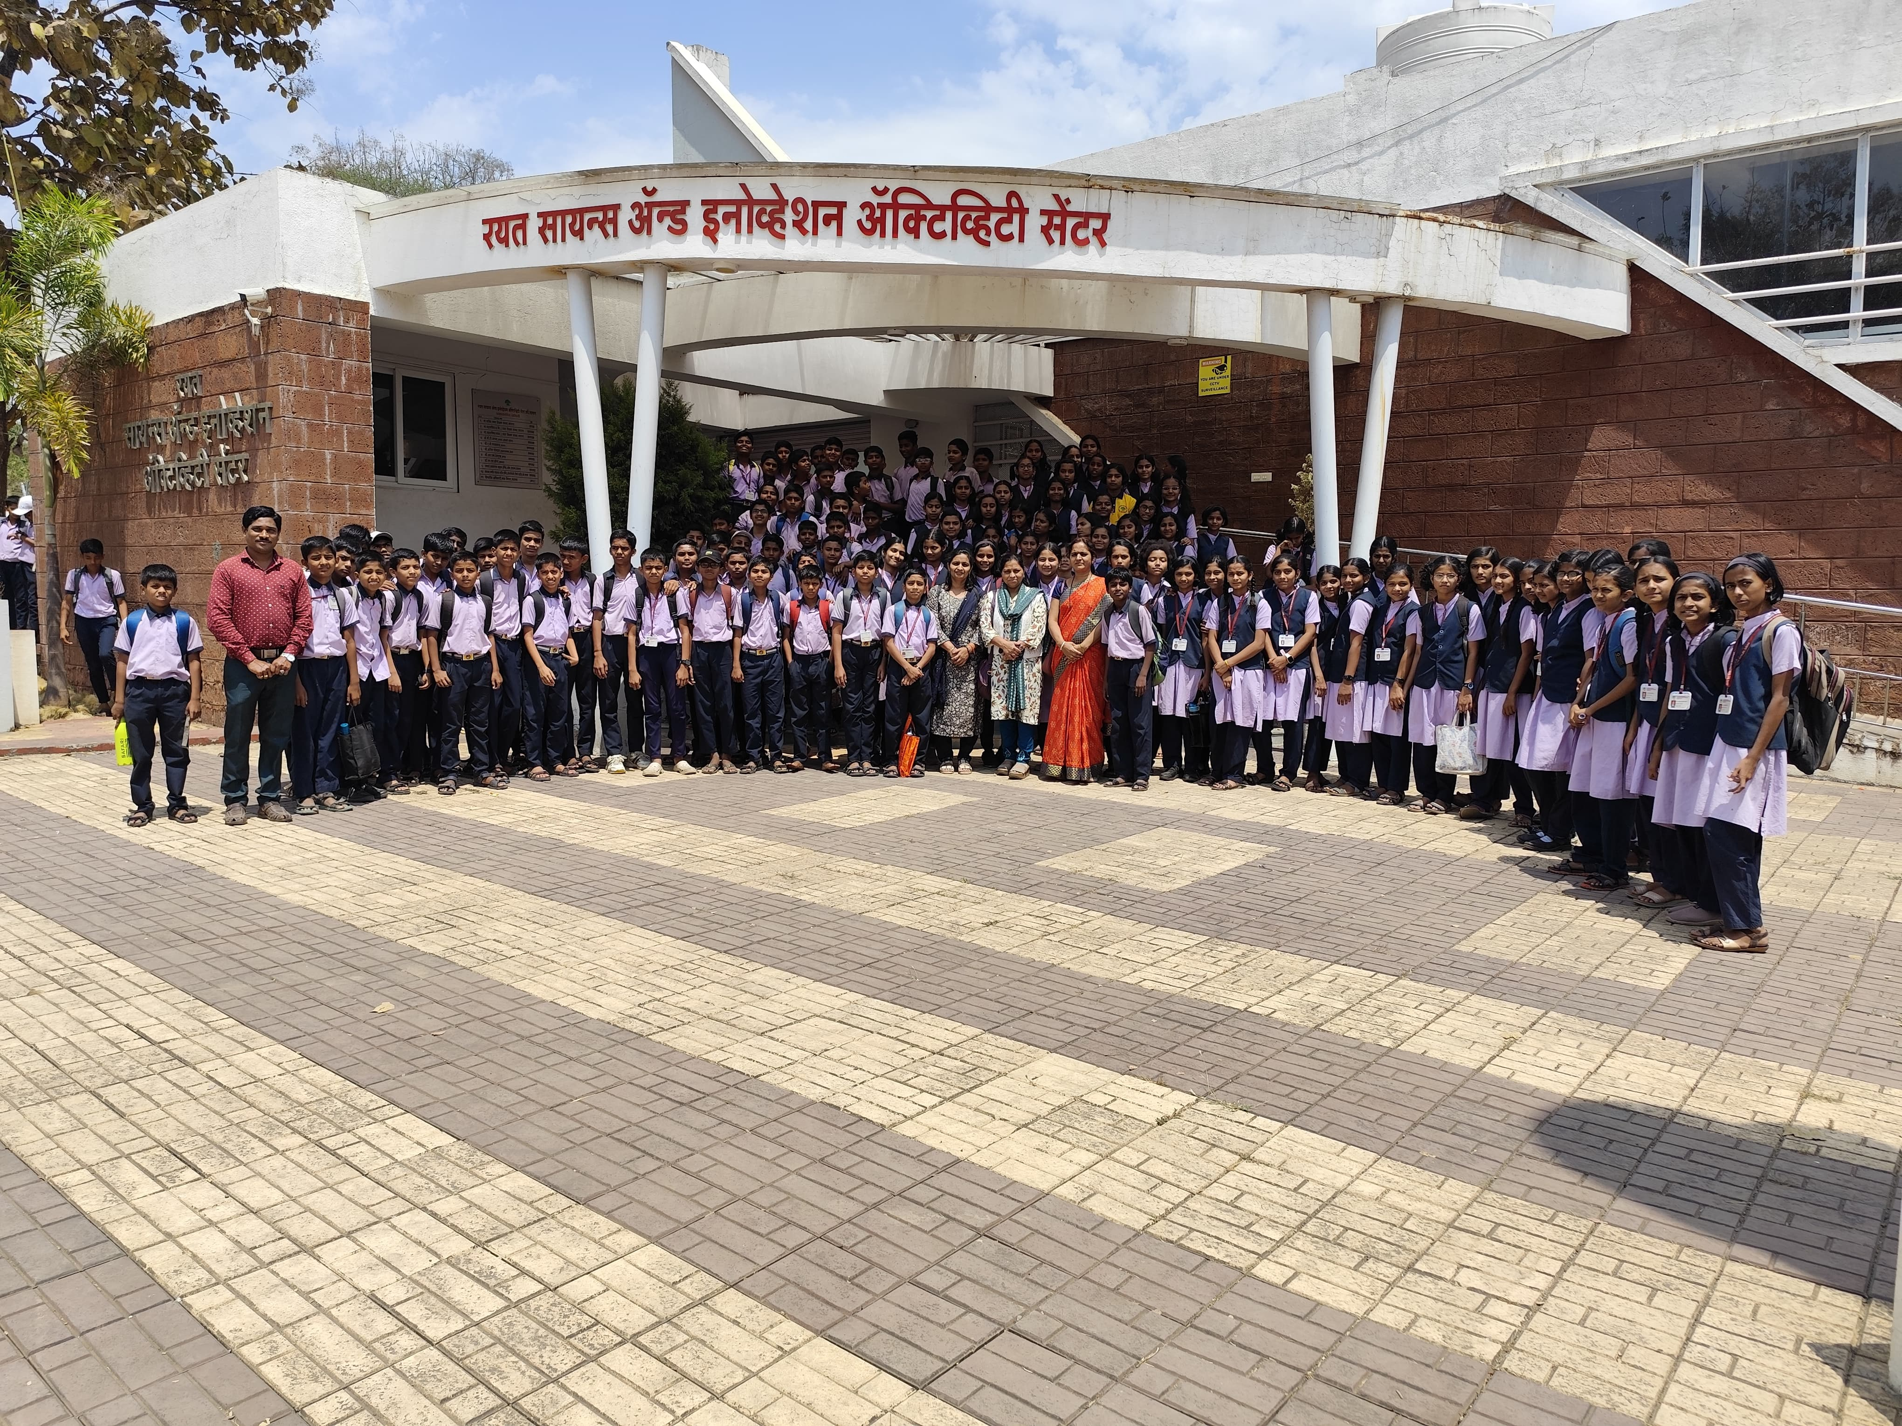
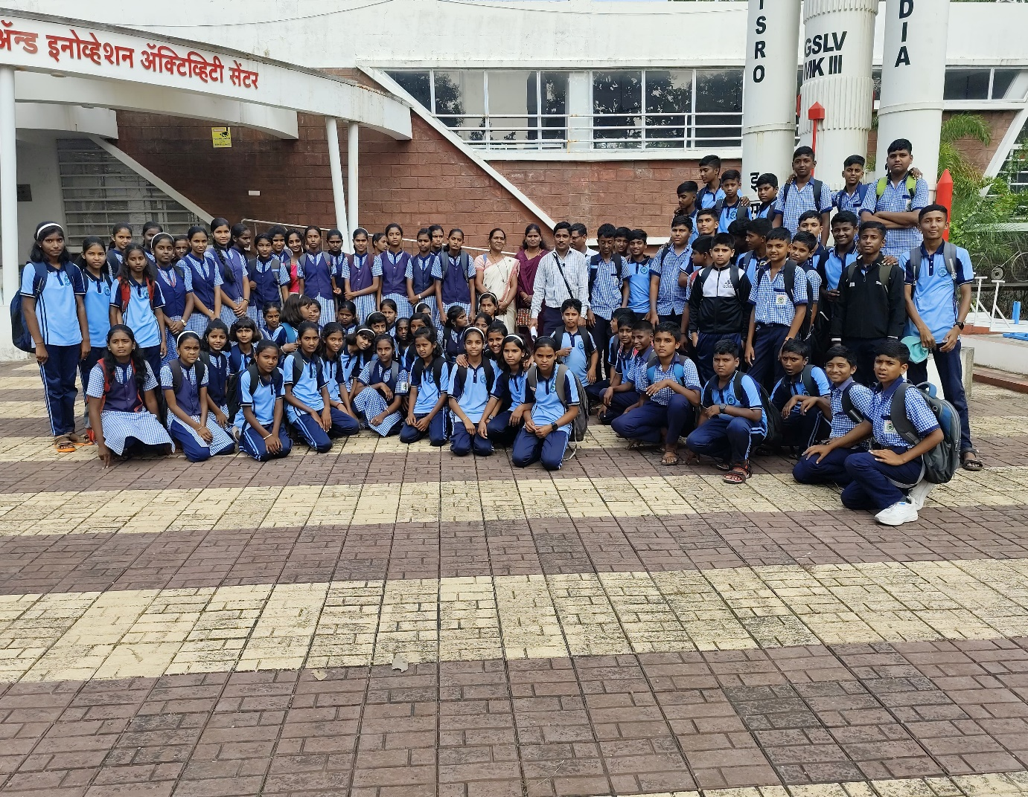
Number of Visitors in 2024-2025
Sr. | Month | Count
1 | April 2024 | 341
2 | May 2024 | 109
3 | June 2024 | 47
4 | July 2024 | 302
5 | August 2024 | 370
6 | September 20 24 | 361
7 | October 2024 | 240
8 | November 2024 | 177
9 | December 2024 | 1190
10 | January 2025 | 1287
11 | February 2025 | 510
12 | March 2025 | 1607
Participants in Outreach and Extension Activities |  | 6674
Total Count |  | 13215
from 01 April 2024 to 31 March 2025.

Slide 7
Memorandum of Understanding (MoU)
RSIAC has signed an MoU with eight schools to conduct the extension activities like liquid nitrogen show, sky gazing activity and science experimentations.
Sr. | Name of the School and address | Number of students benefited.
1 | Maharaja Syajirav Vidyalay, Satara. | 1410
2 | Aannasaheb Kalyani Vidyalay, Satara. | 1260
3 | Bhimabai Ambedakar Kanya Vidyamandir, Satara. | 420
4 | Ra.Ba. Kale Vidyalay, Satara. | 133
5 | Satara Primary School, Satara. | 133
6 | Jijamata Practicing School, Satara. | 190
7 | Rayat Marathi School, Satara. | 226
8 | Apasaheb Bhaurao Patil English Medium, School, Satara. | 1111
 | Total | 4883
Revenue generated of Rs. 5 Lacs in 2024-2025.

Slide 8
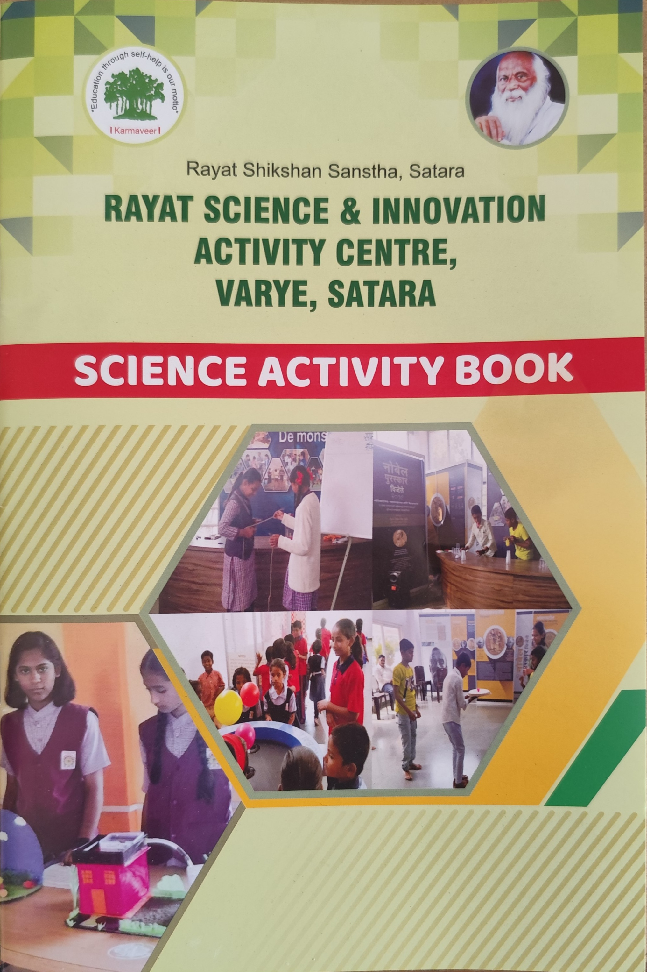
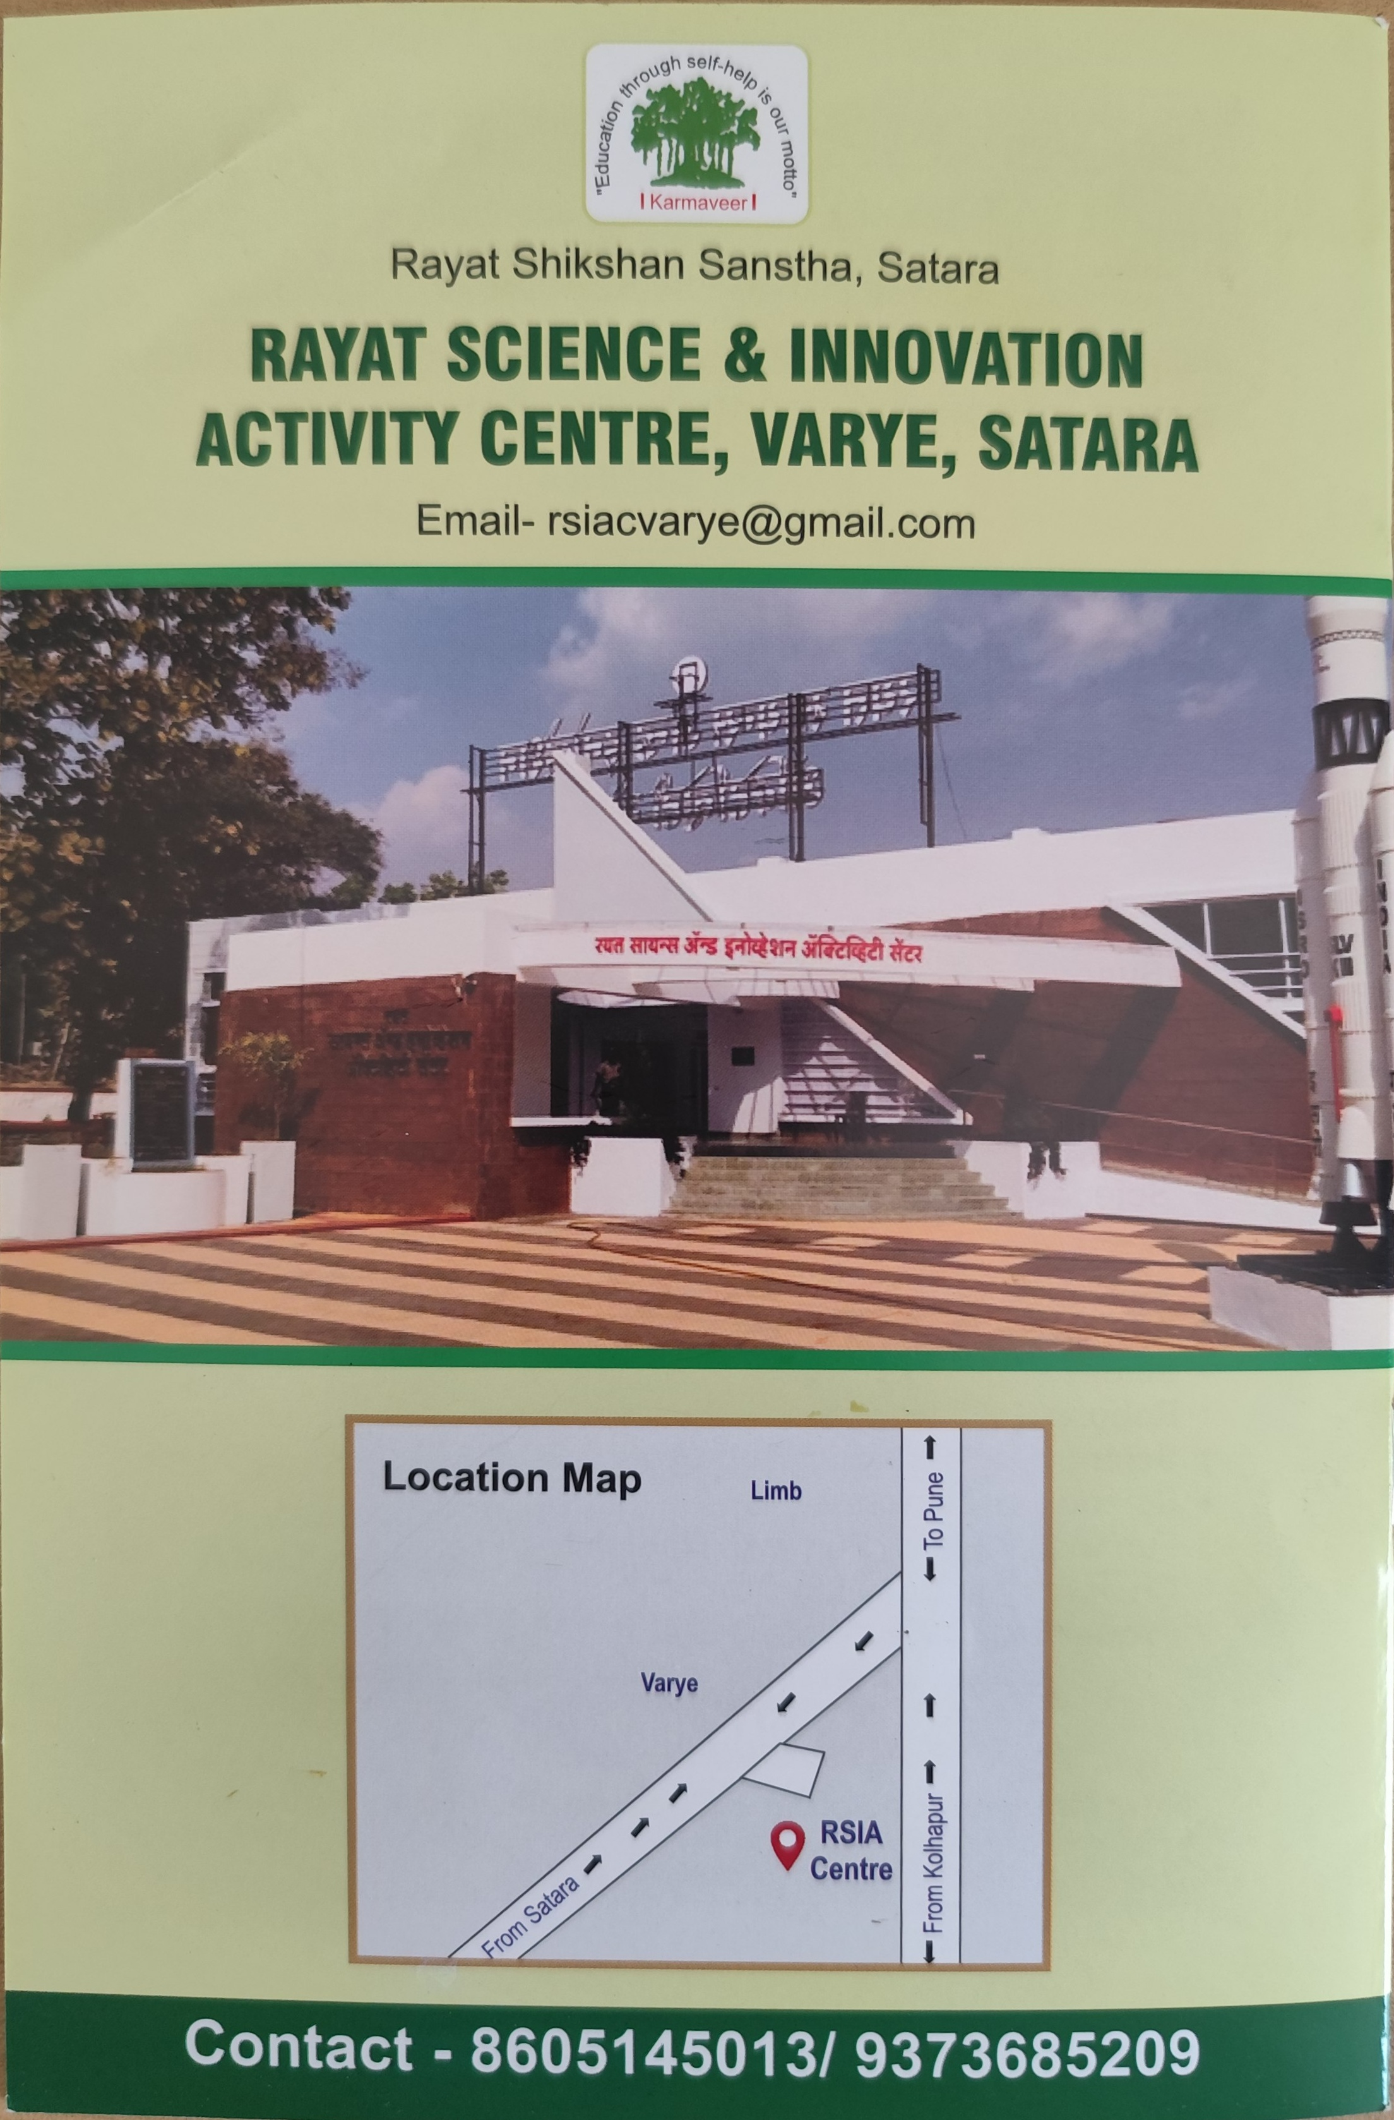
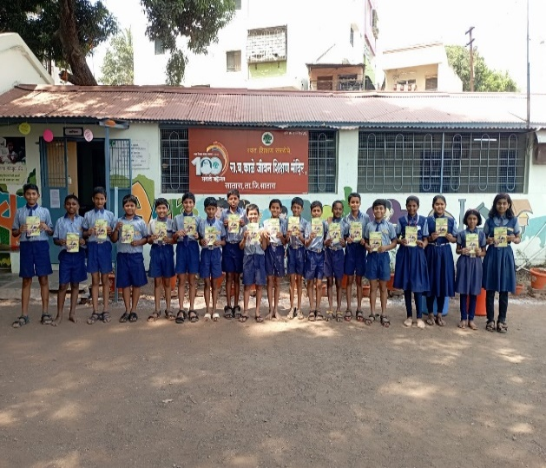
Science Book
In this academic year at RSIAC, Satara we have developed the science book which gives insights into the basic science related experimentation, which students can do at home. The said book is distributed to 4883 students of 5th to 9th standard students of schools with whom the RSIAC has signed an MoU.

Slide 9
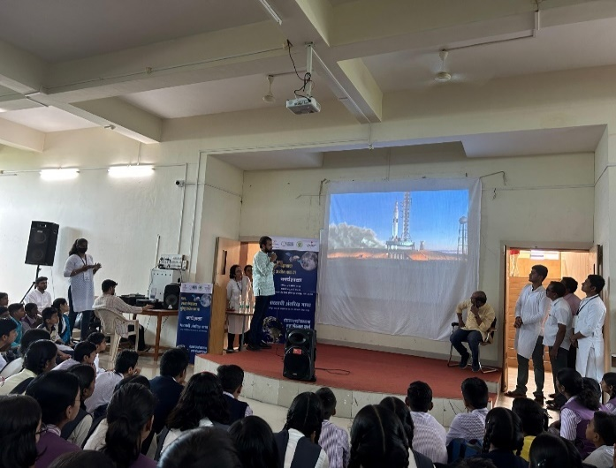
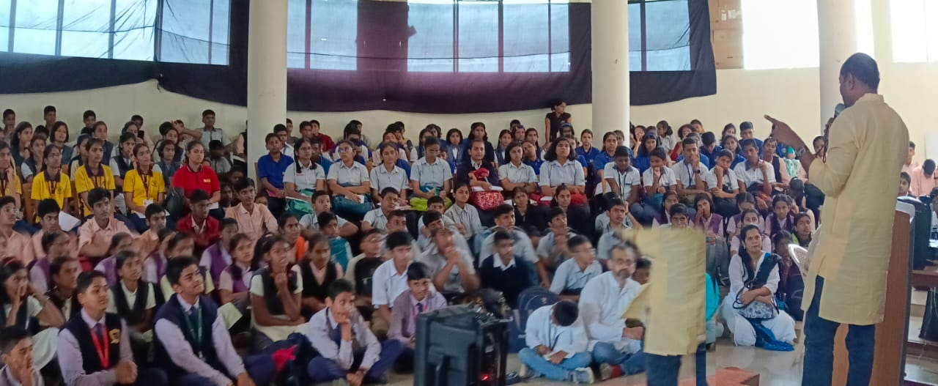
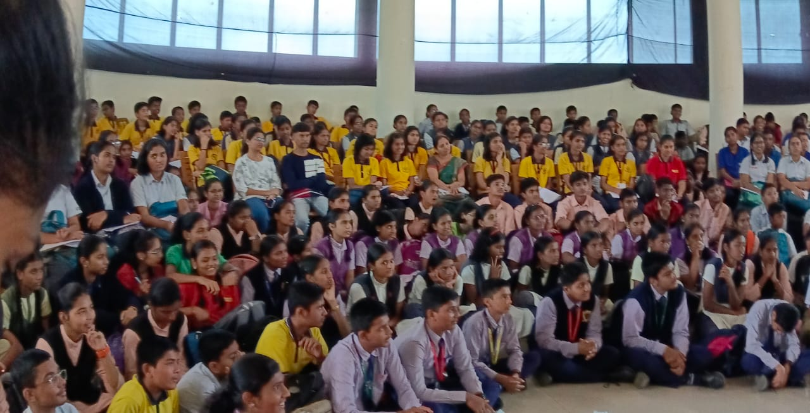
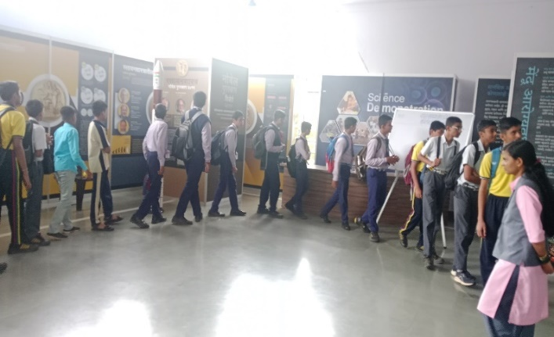
ISRO Workshop : 31.08.2024
RSIAC organized a workshop in collaboration with Pune-based Earth Sight Foundation and Deepstambh Charitable Trust Pune, 292 students, teachers, sarpanches, gram sevaks, and staff from various schools and colleges across the district—were in attendance."

Slide 10
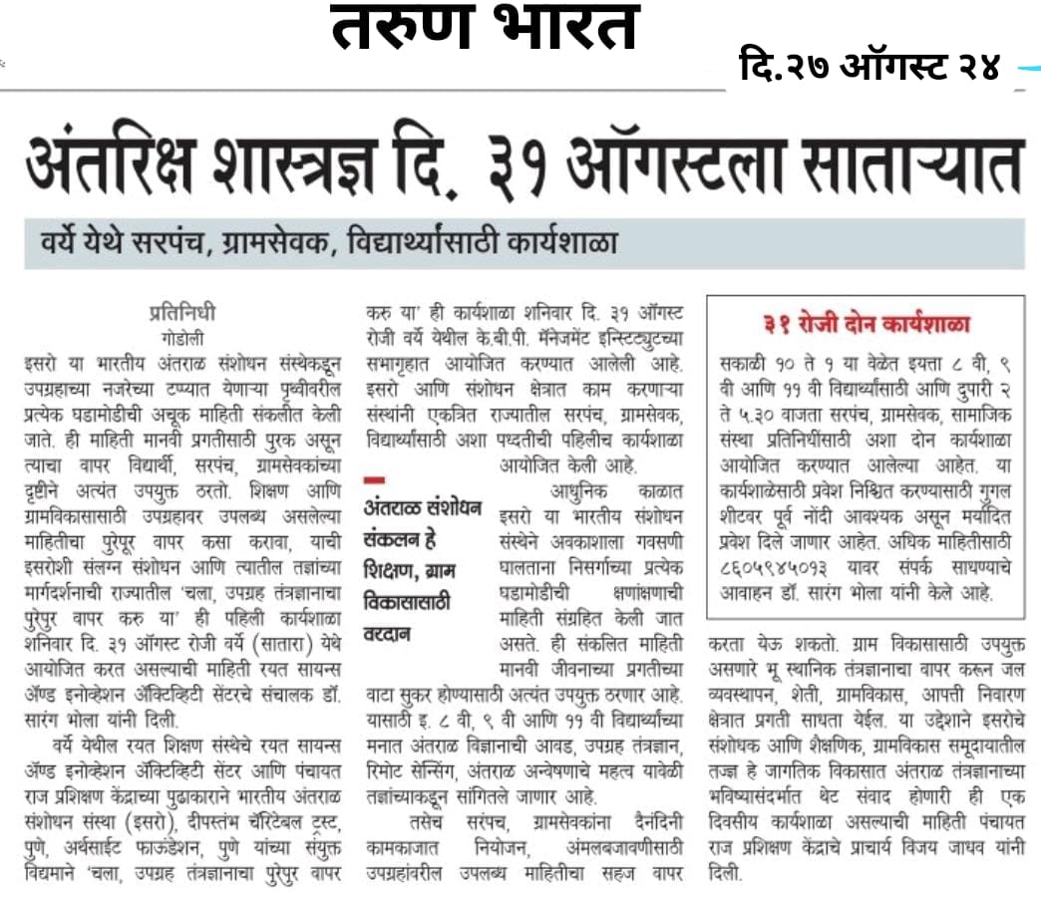
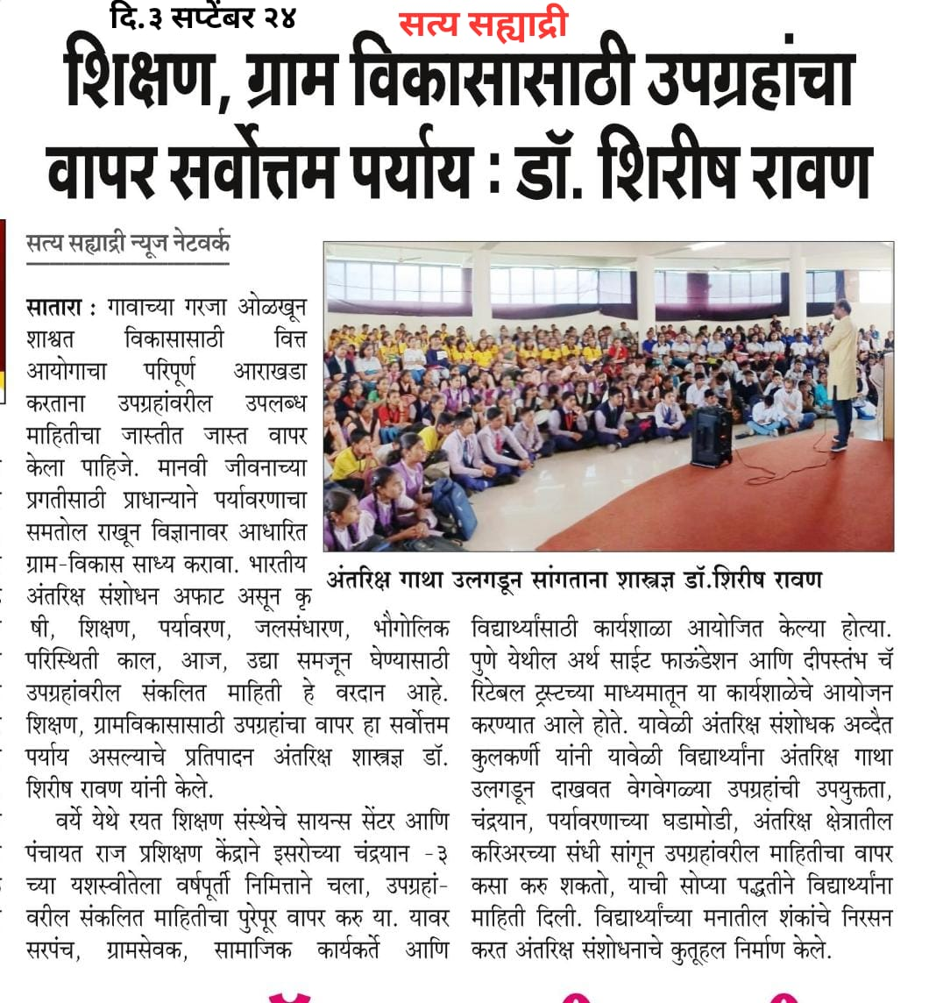
ISRO Workshop : 31.08.2024

Slide 11
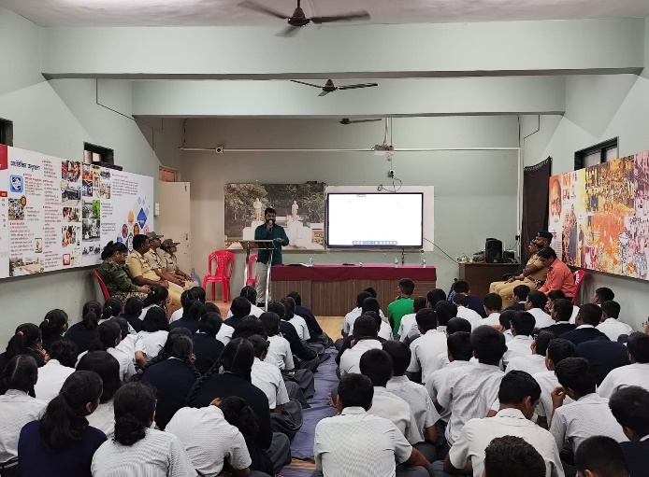
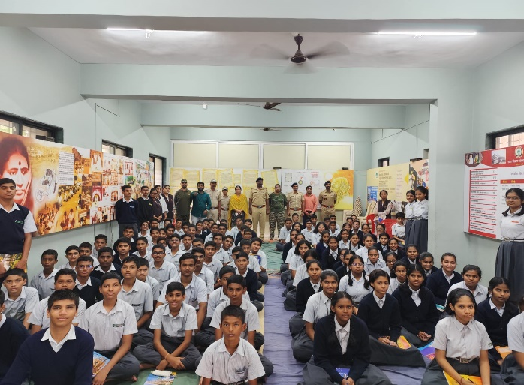
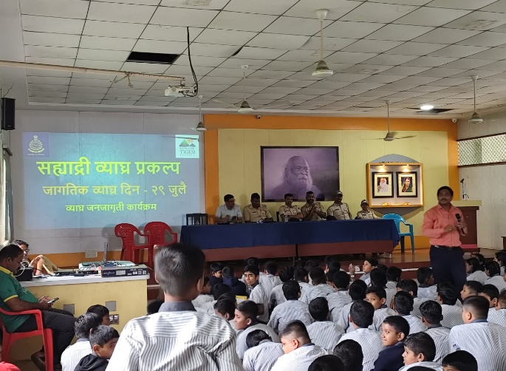
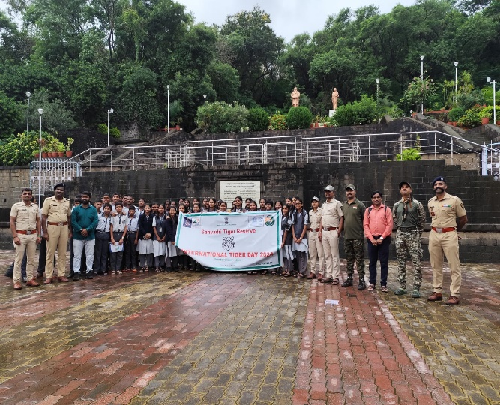
National Tiger Day: 29.07.2024
“National Tiger Day “ was celebrated in collaborated with Sahyadri Tiger Reserve Karad, Satara. celebrated with students of Maharaja Sayajirao School, Satara and Appasaheb Bhaurao Patil English Medium School Satara.
409 students attended the National Tiger Day celebration activities.

Slide 12
Activities Conducted in the year 2024-2025
Sr. | Date | Activities | Number of Participant
1 | 23/04/2024 | Sky Gazing | 290
2 | 25/04/2024 | Liquid Nitrogen Gas Show | 20
3 | 04/05/2024 | One Day Summer Camp for 4th to 6th Std Student | 84
4 | 20/05/2024 to 23/05/2024 | Four Day Summer Camp for 7th to 9th standard students | 20
5 | 22/05/2024 | Liquid Nitrogen Gas Show | 180
6 | 28/06/2024 | Quiz Competition | 16
7 | 29/07/2024 | National Tiger Day Celebrate | 409
8 | 31/08/2024 | ISRO Workshop 2024 for School Student and Gram panchayat Sarapanch | 360
9 | 07/10/2024 | Quiz and Slogan Writing Competition | 34
10 | 23/12/2024 | Quiz Competition | 16
11 | 29/12/2024 | Sunday Science School – Fun Activity -1 | 25
12 | 05/01/2025 | Sunday Science School – Fun Activity -2 | 37
13 | 12/01/2025 | Sunday Science School – Fun Activity -3 | 20
14 | 24/01/2025 | Sky Gazing 2025 – Planet Parade | 100
15 | 28/02/2025 | National Science Day - 2025 | 180
 |  | Total | 1791

Slide 13
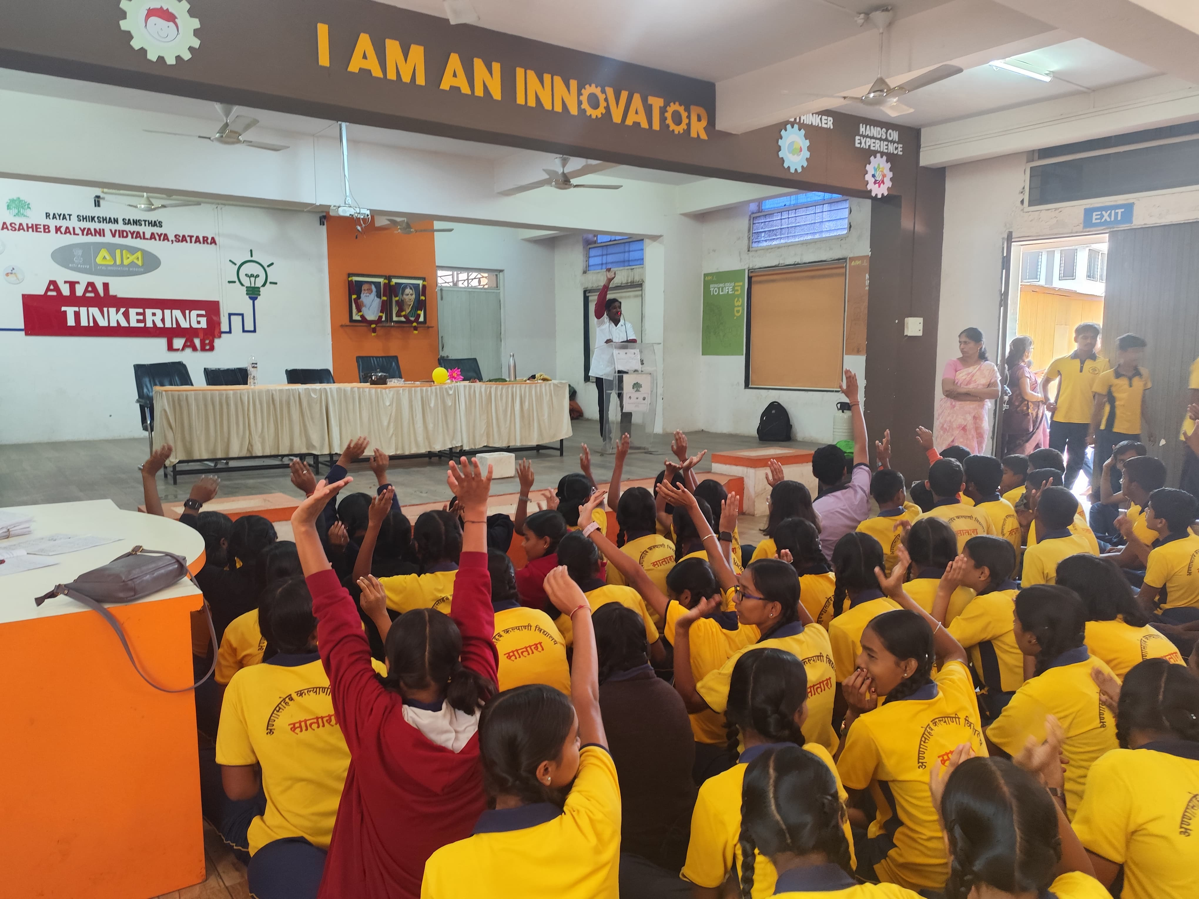
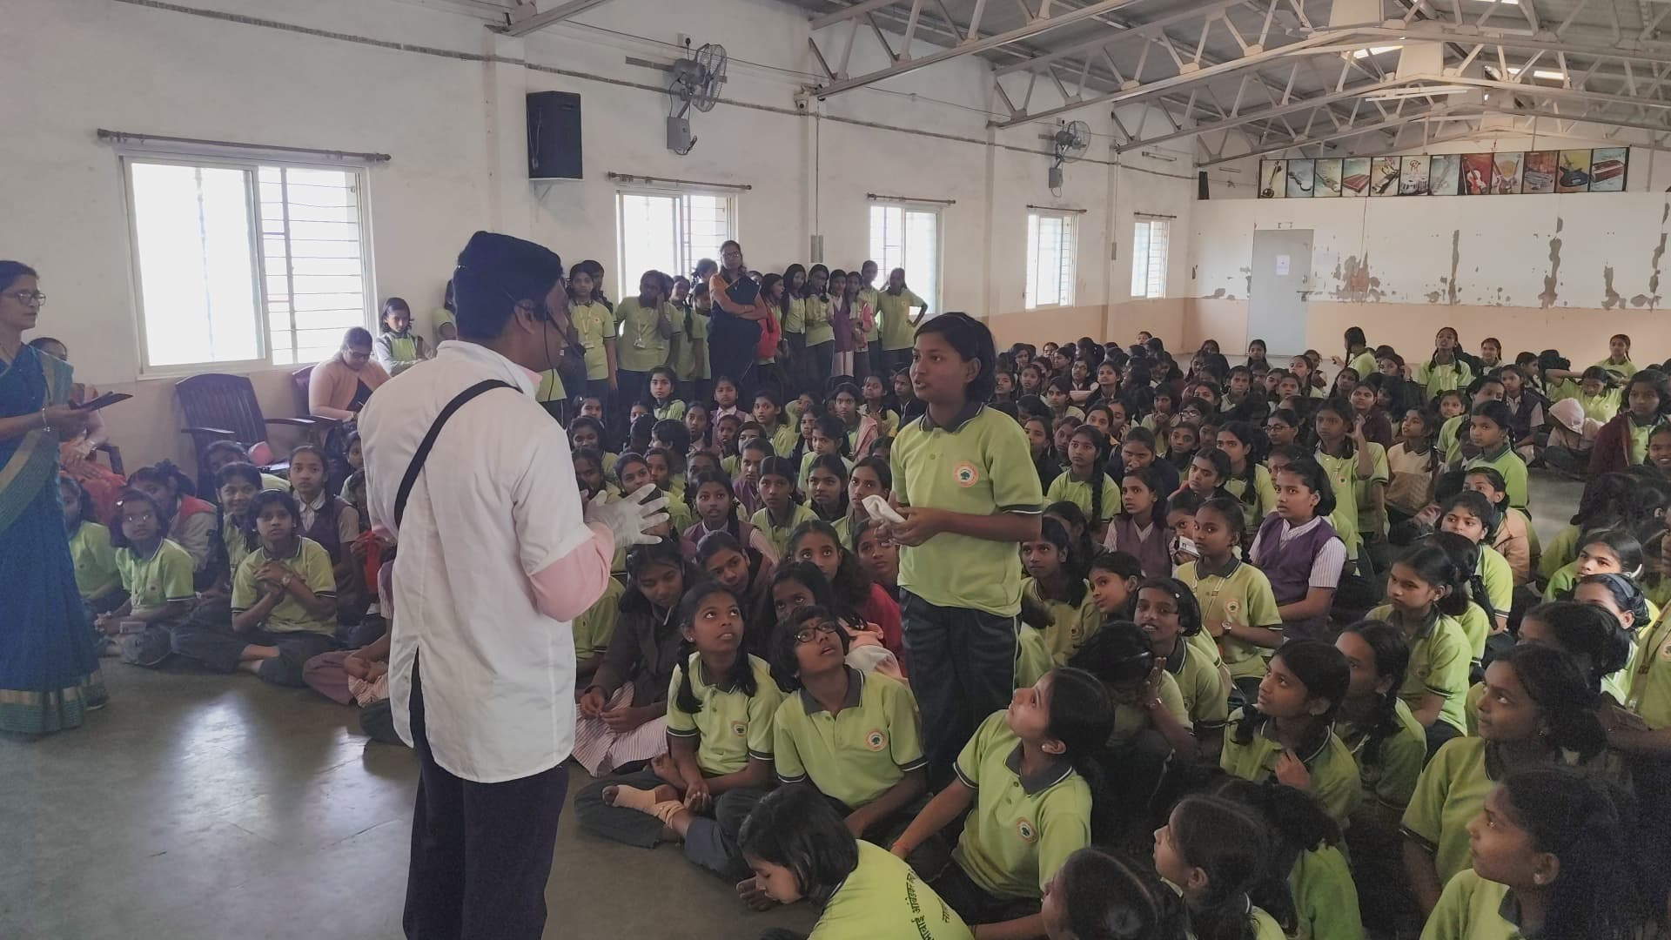
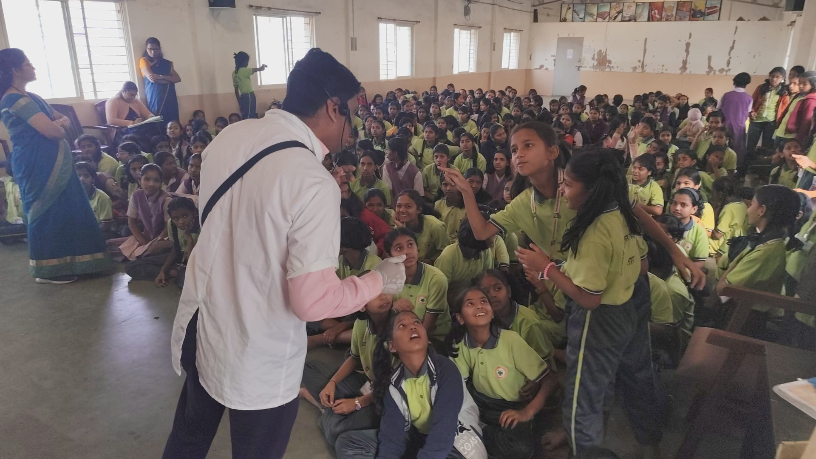
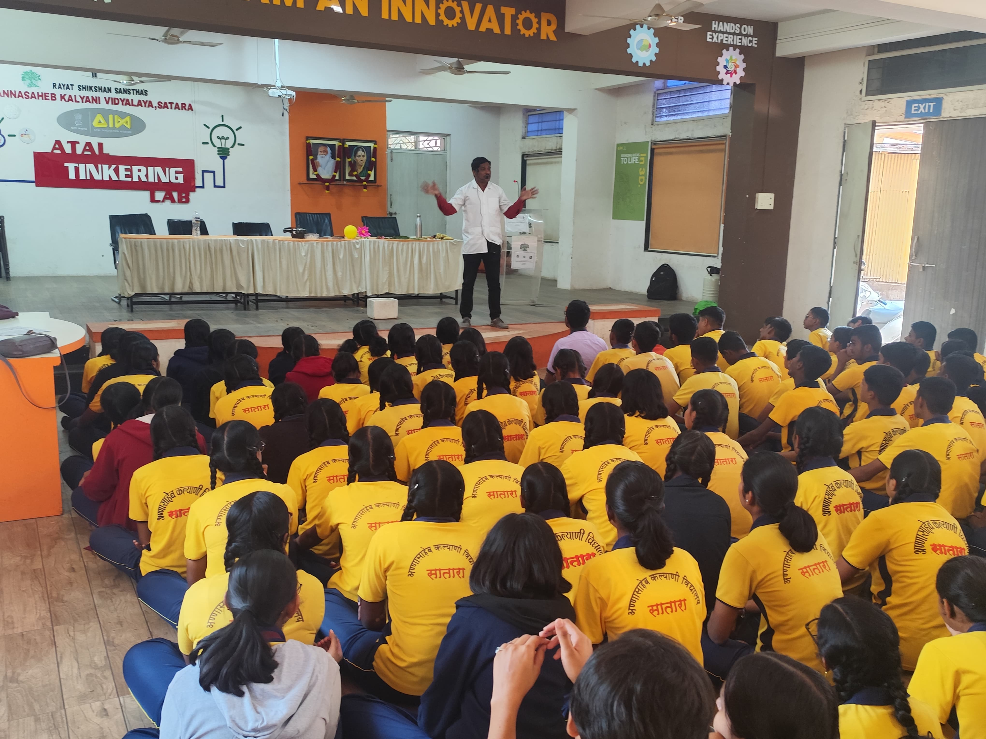
The photographs of the activities conducted at the school
Science Demonstration – Outreach Program

Slide 14
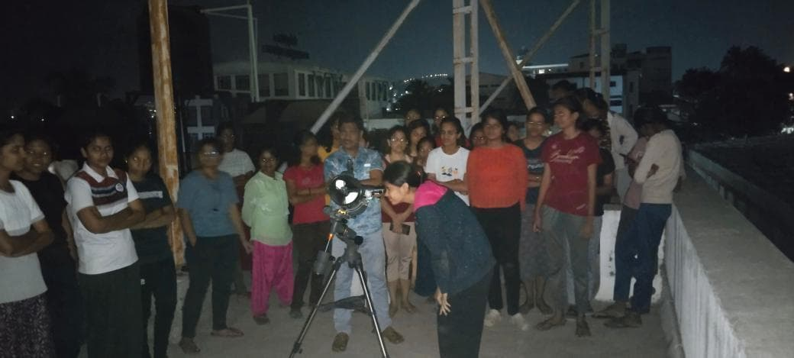
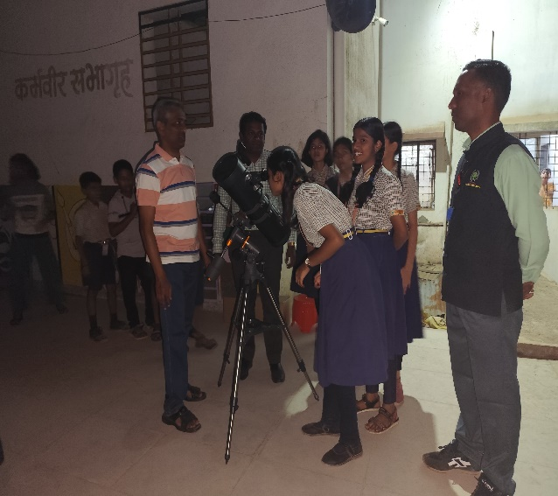
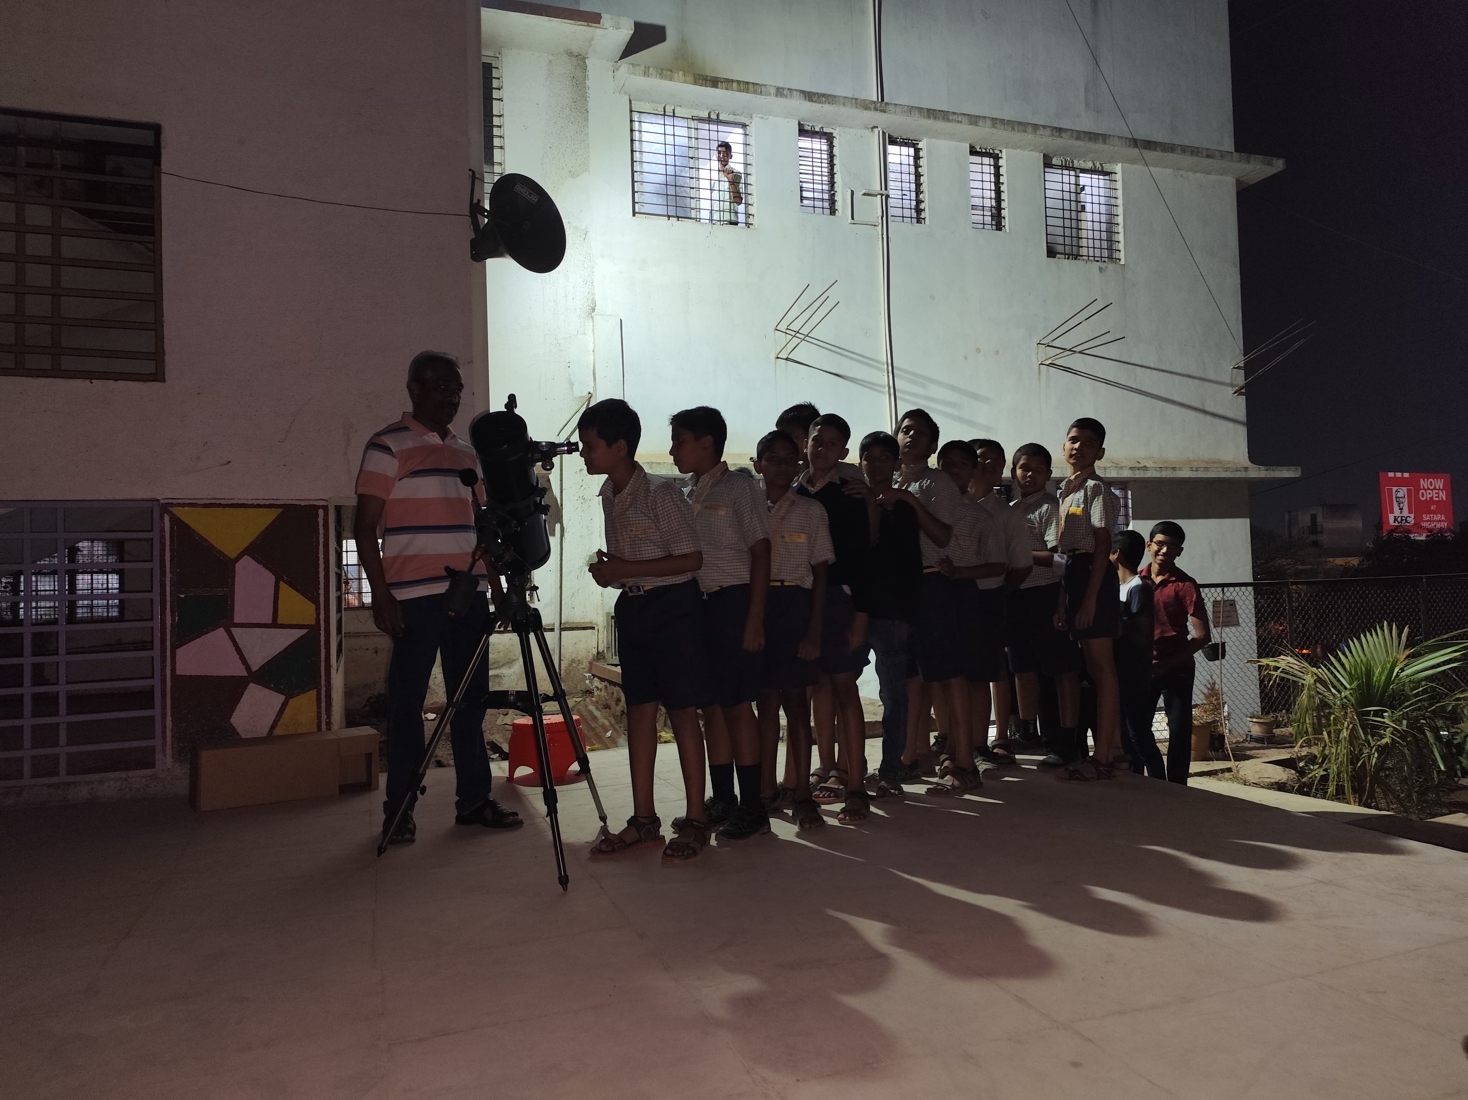
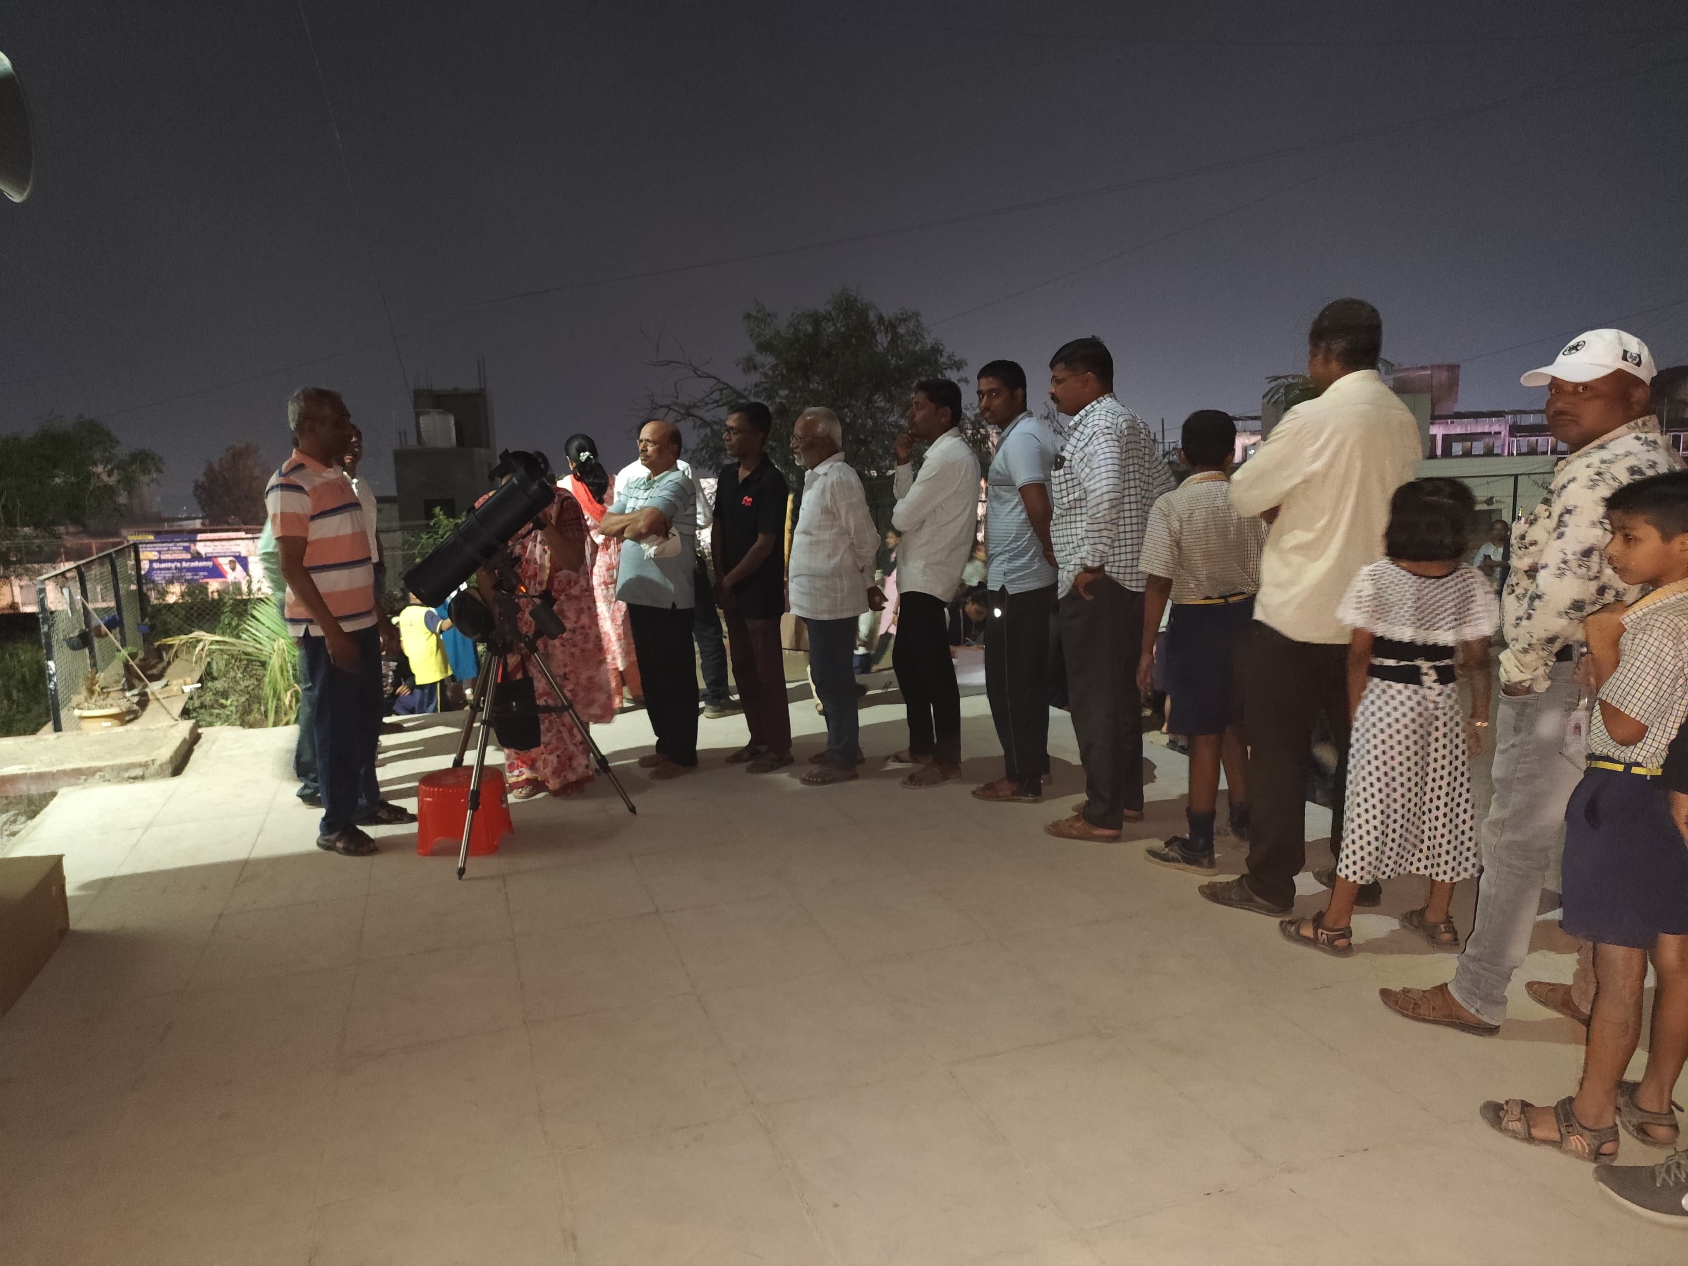
The photographs of the activities conducted at the school
Sky Gazing -2024 – 2025 Outreach Program

Slide 15
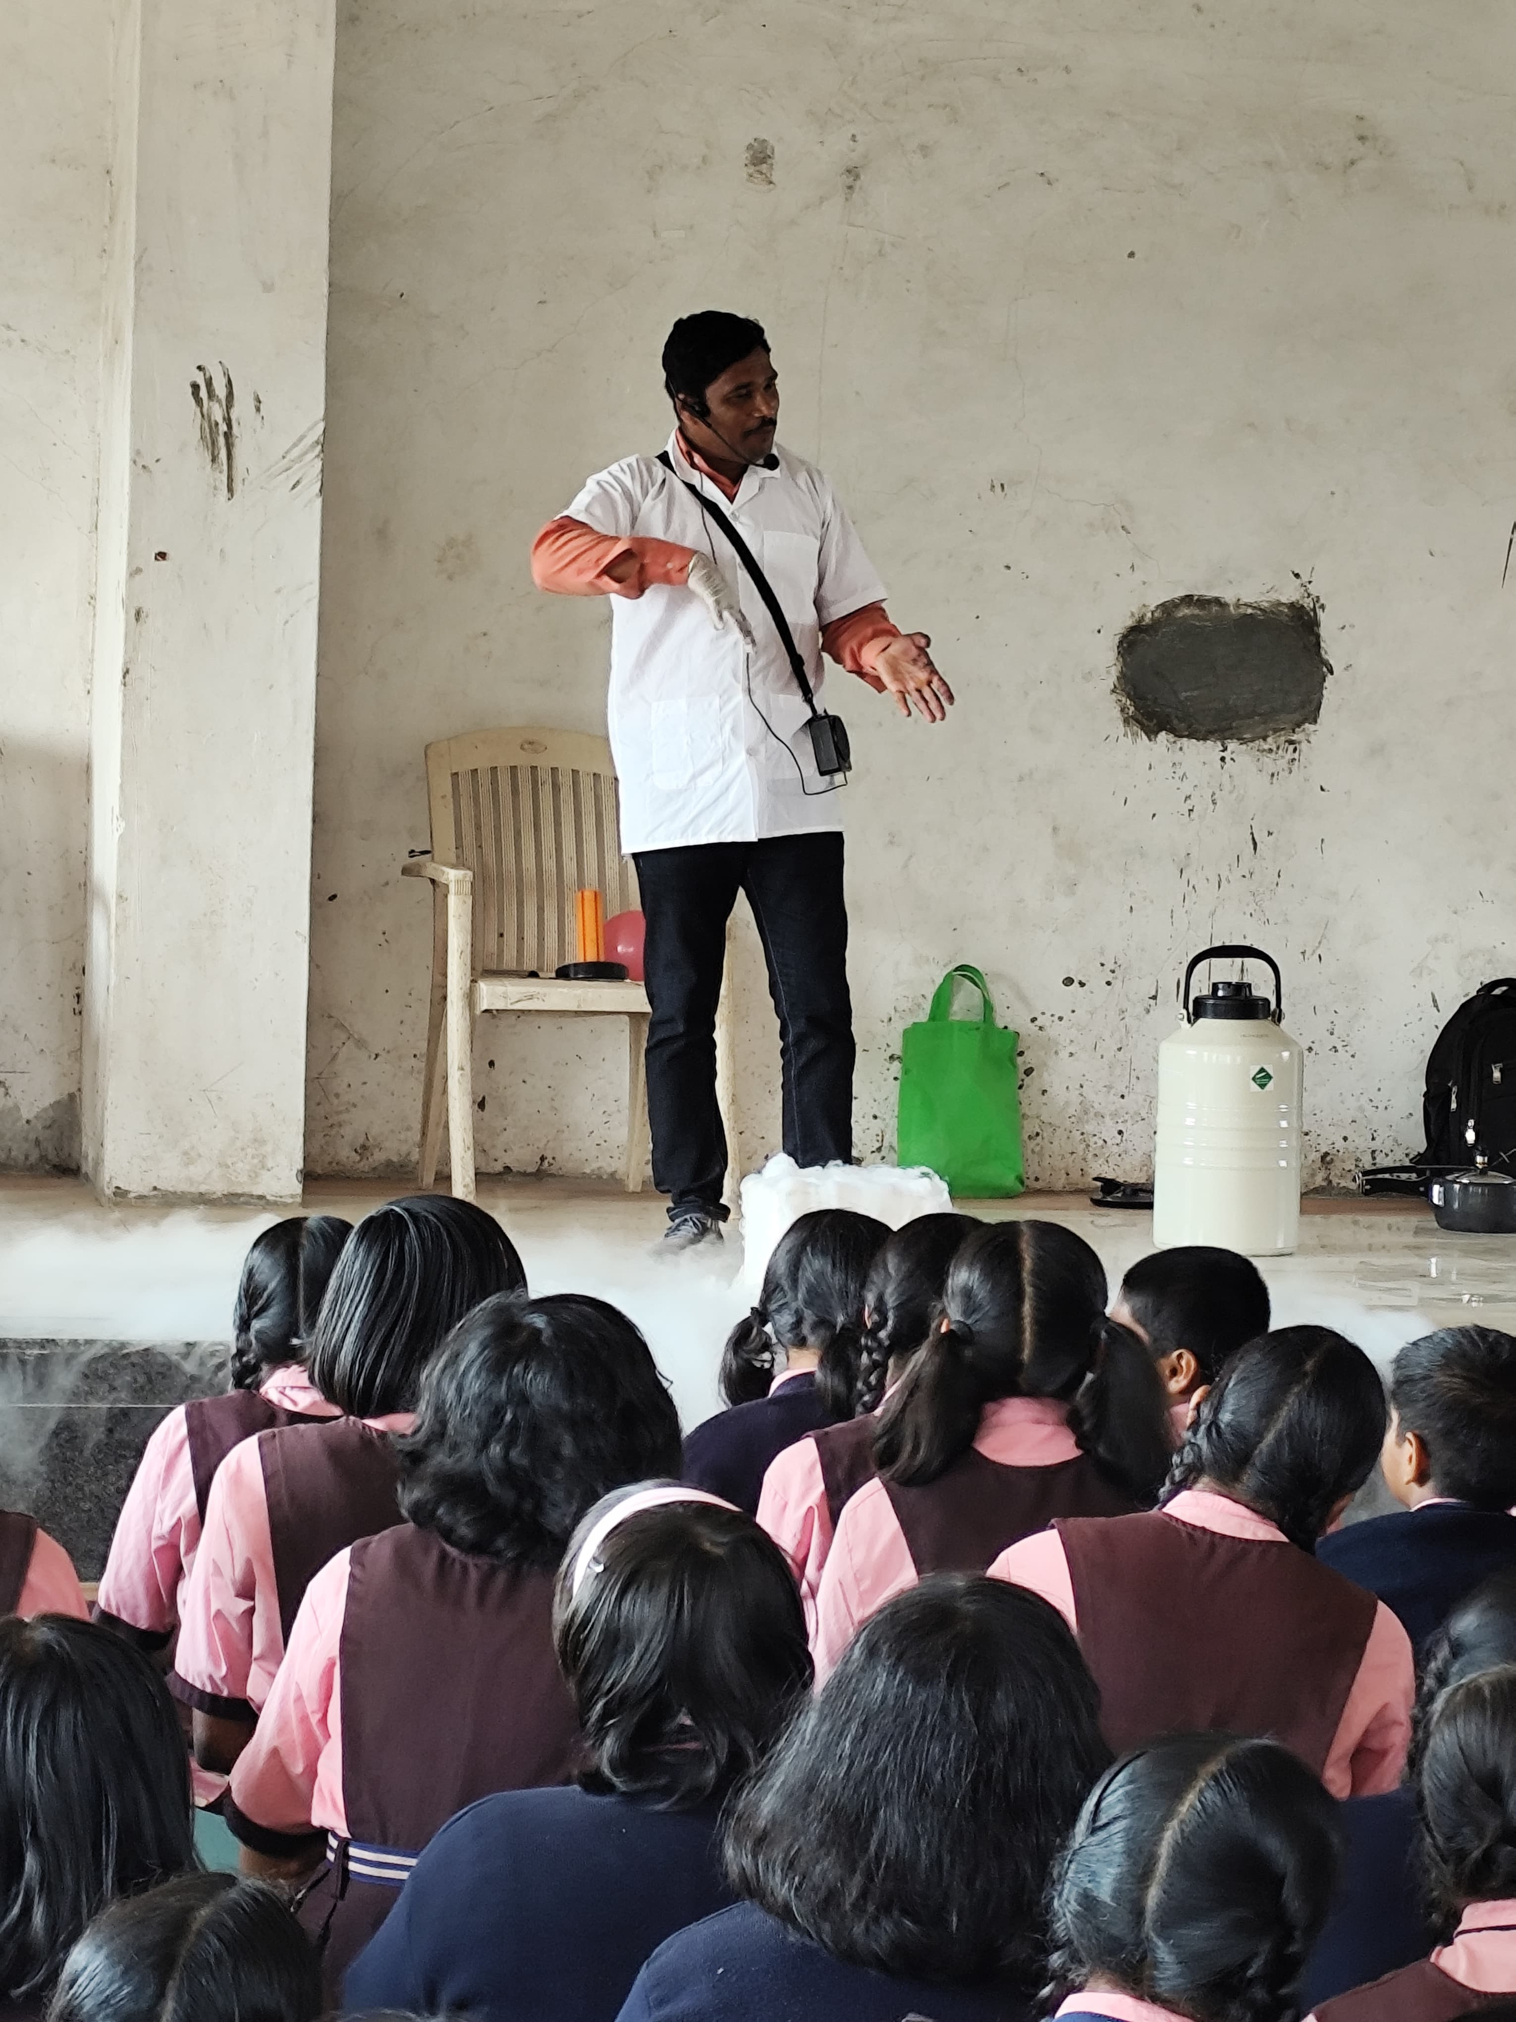
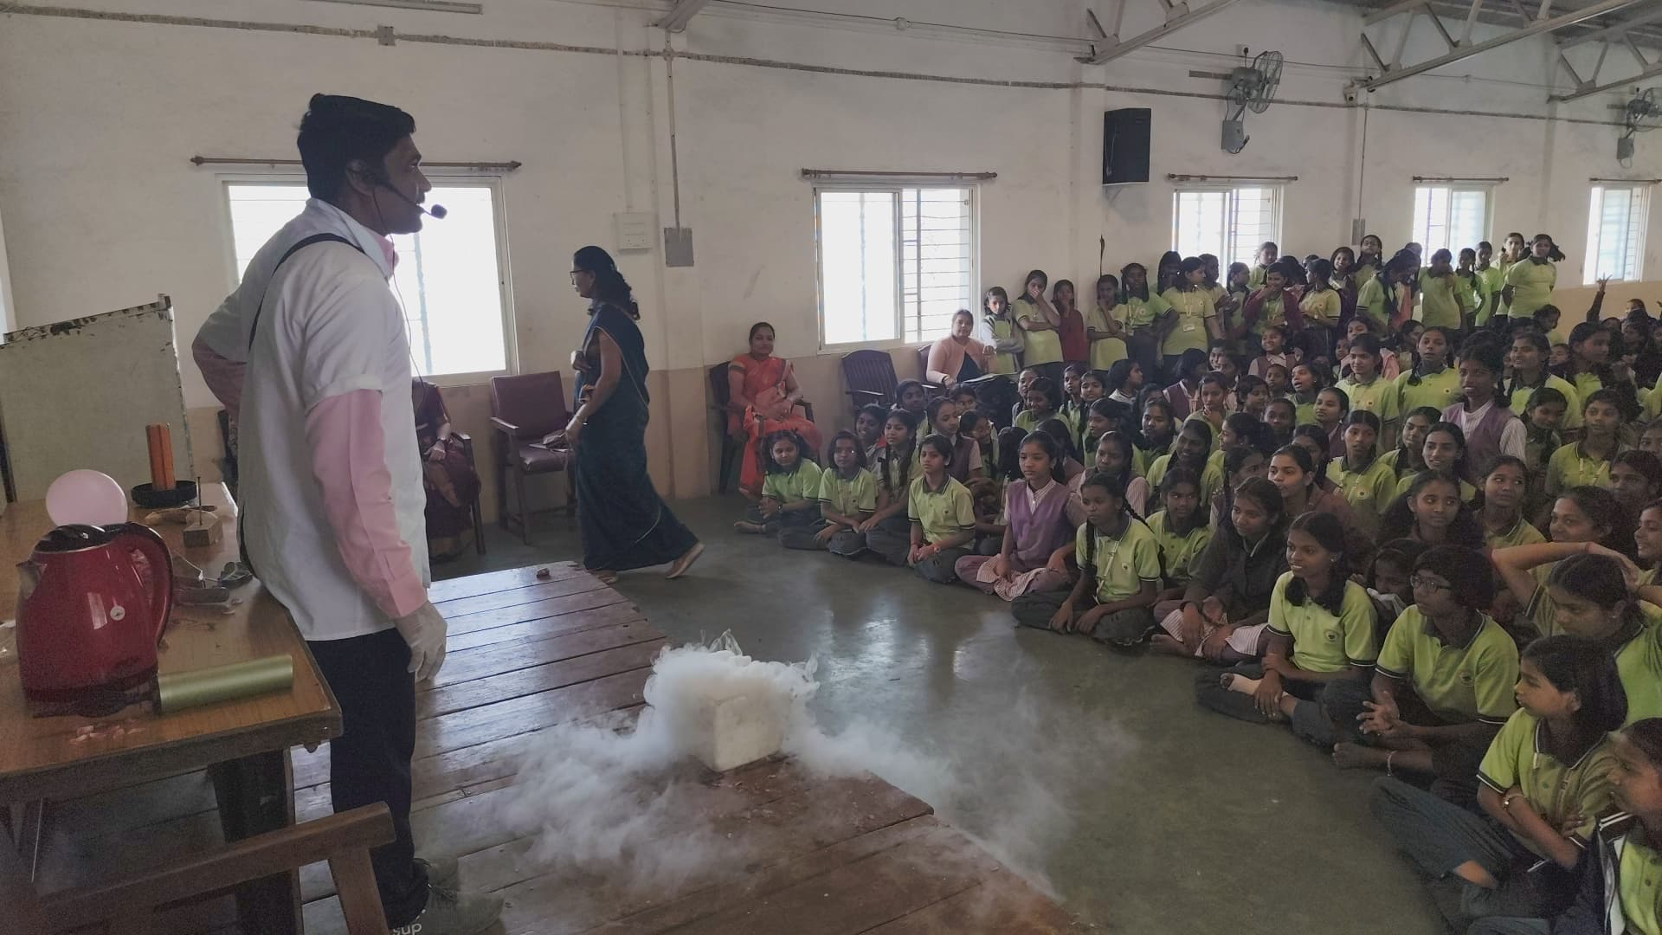
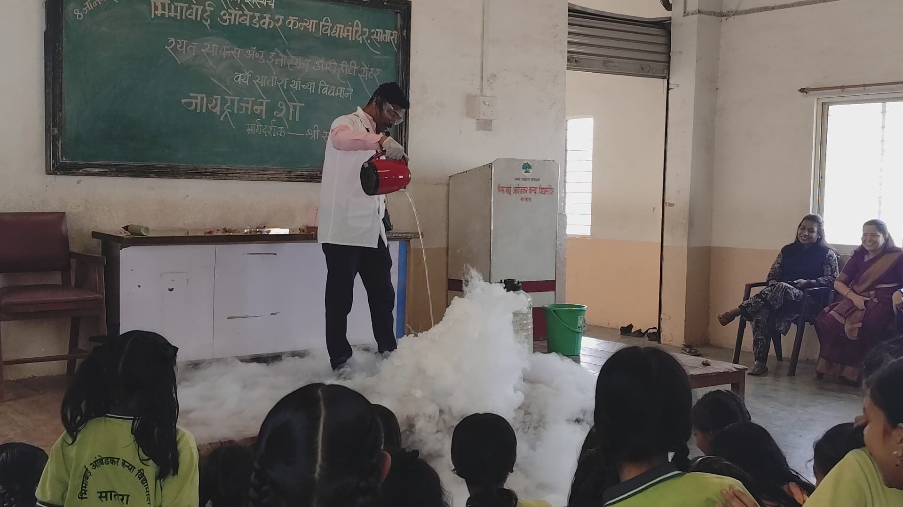
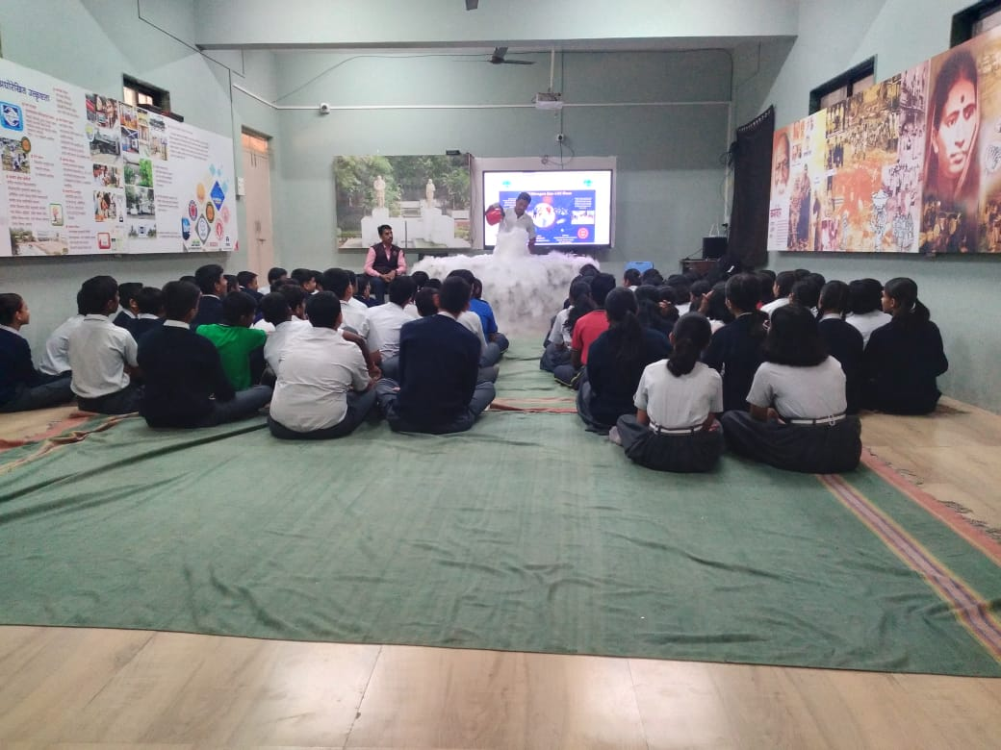
The photographs of the activities conducted at the school
Liquid Nitrogen gas Show - Outreach Program

Slide 16
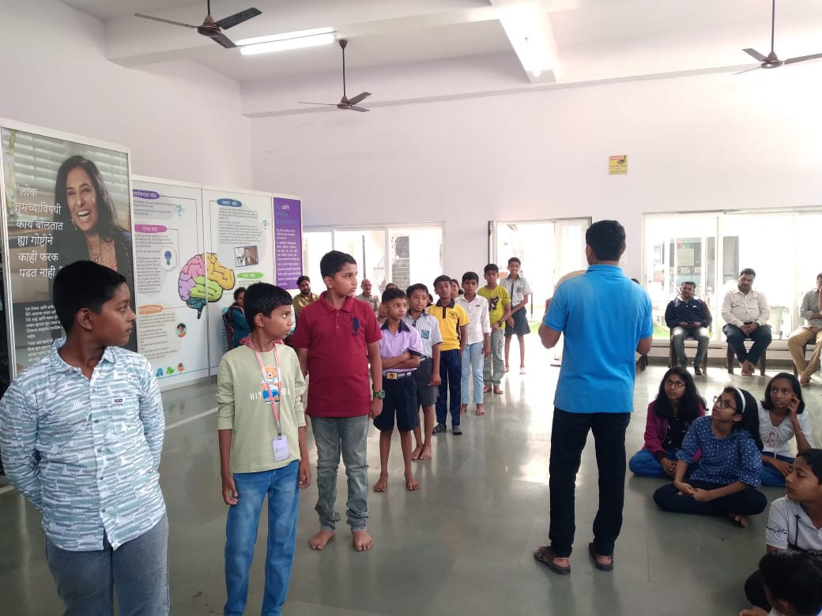
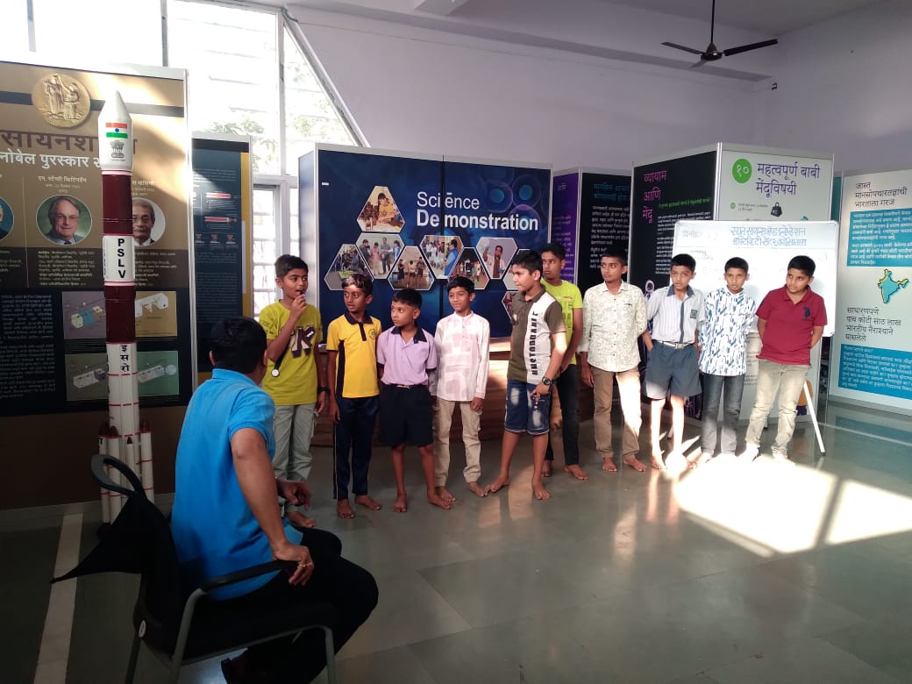
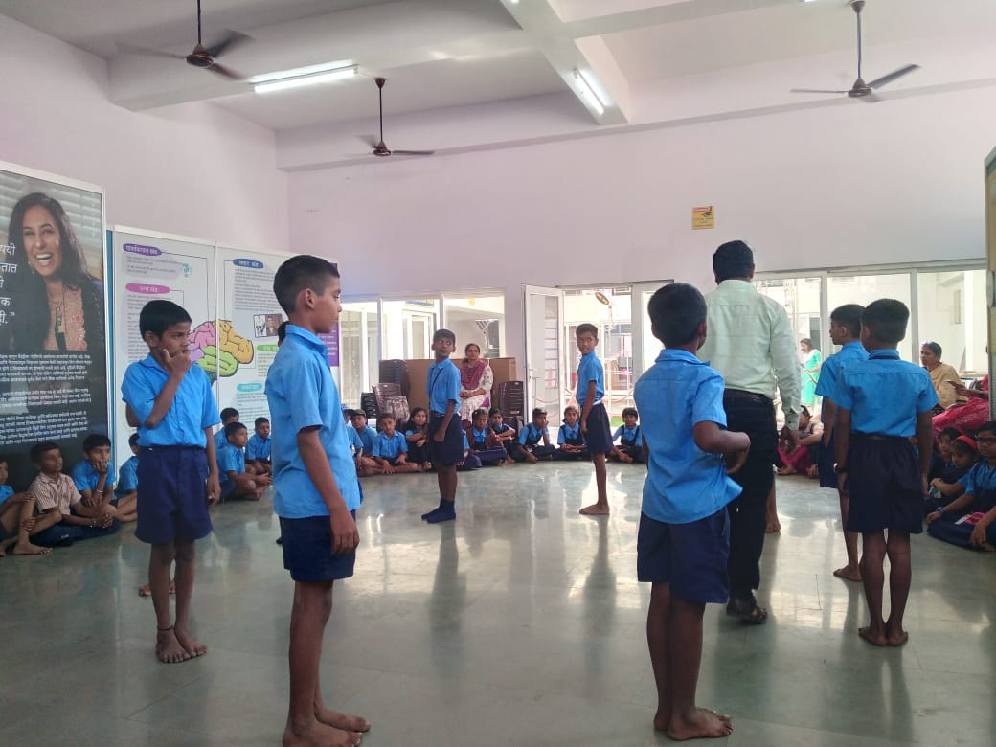
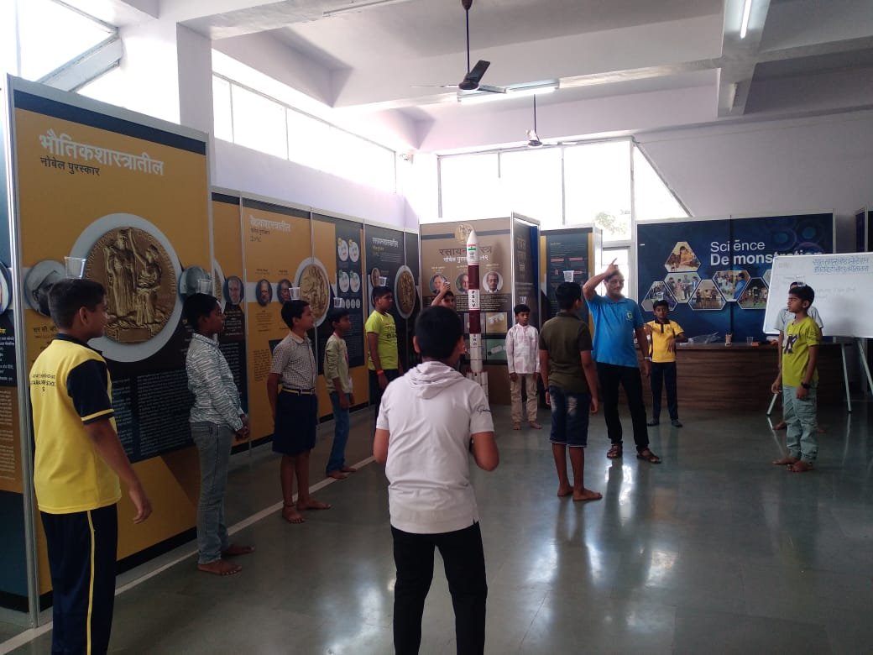
Fun Activity Science School – Fun Activity

Slide 17
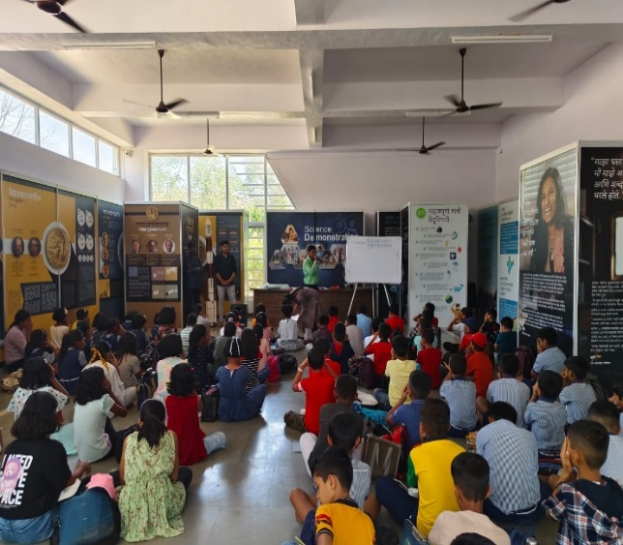
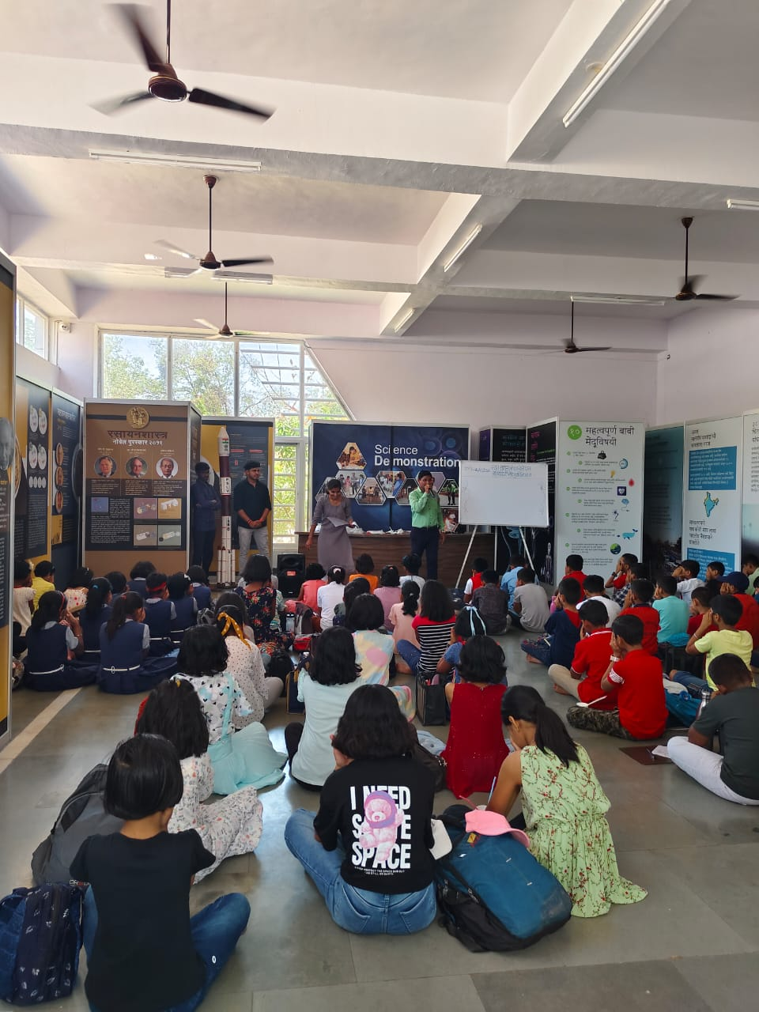
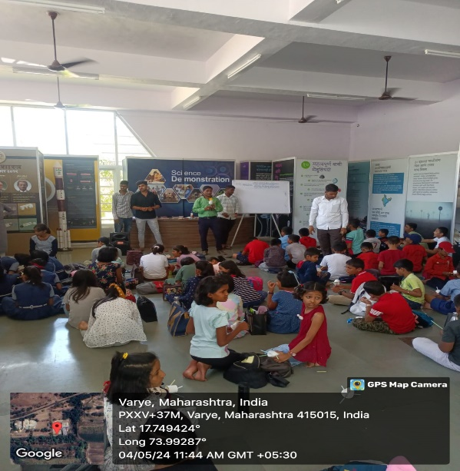
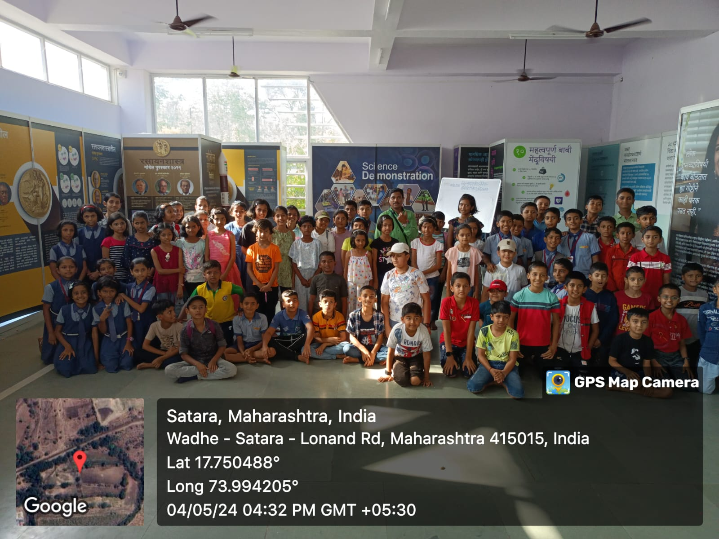
Summer Camp : 04.05.2024
One Day Summer camp on Science Toys from craft for 4th to 6th standard students
Total 84 students participated from different school of this event.

Slide 18
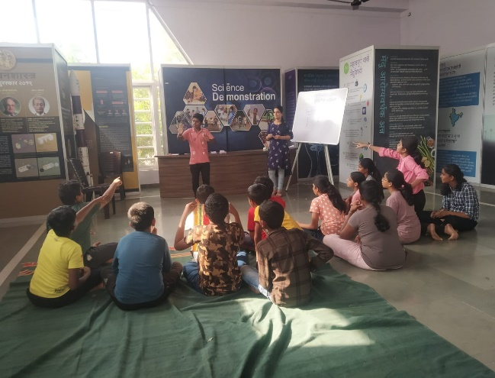
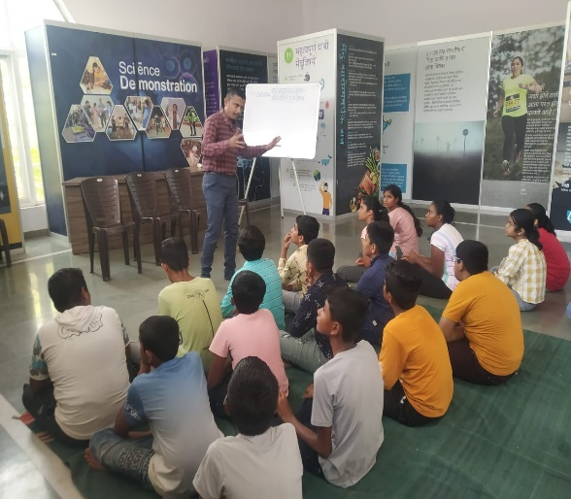
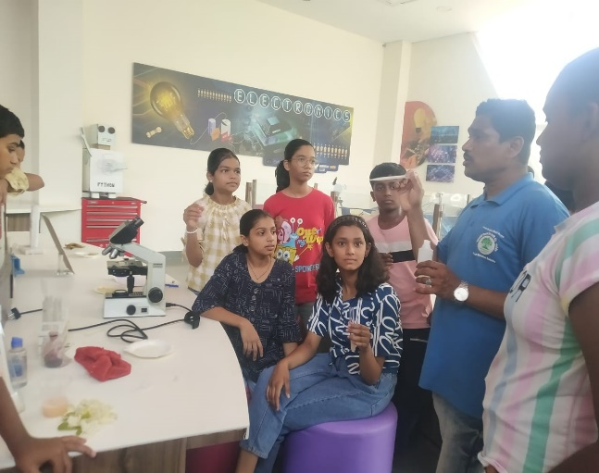
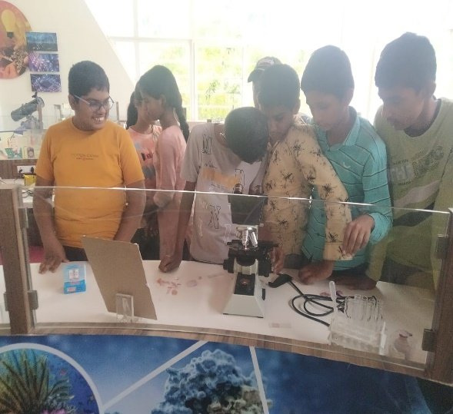
Summer Camp: four days from 20.05.2024 to 23.05.2024
Four Day Summer camp for 7th to 9th standard students.
24 students participated from different school of this event.

Slide 19
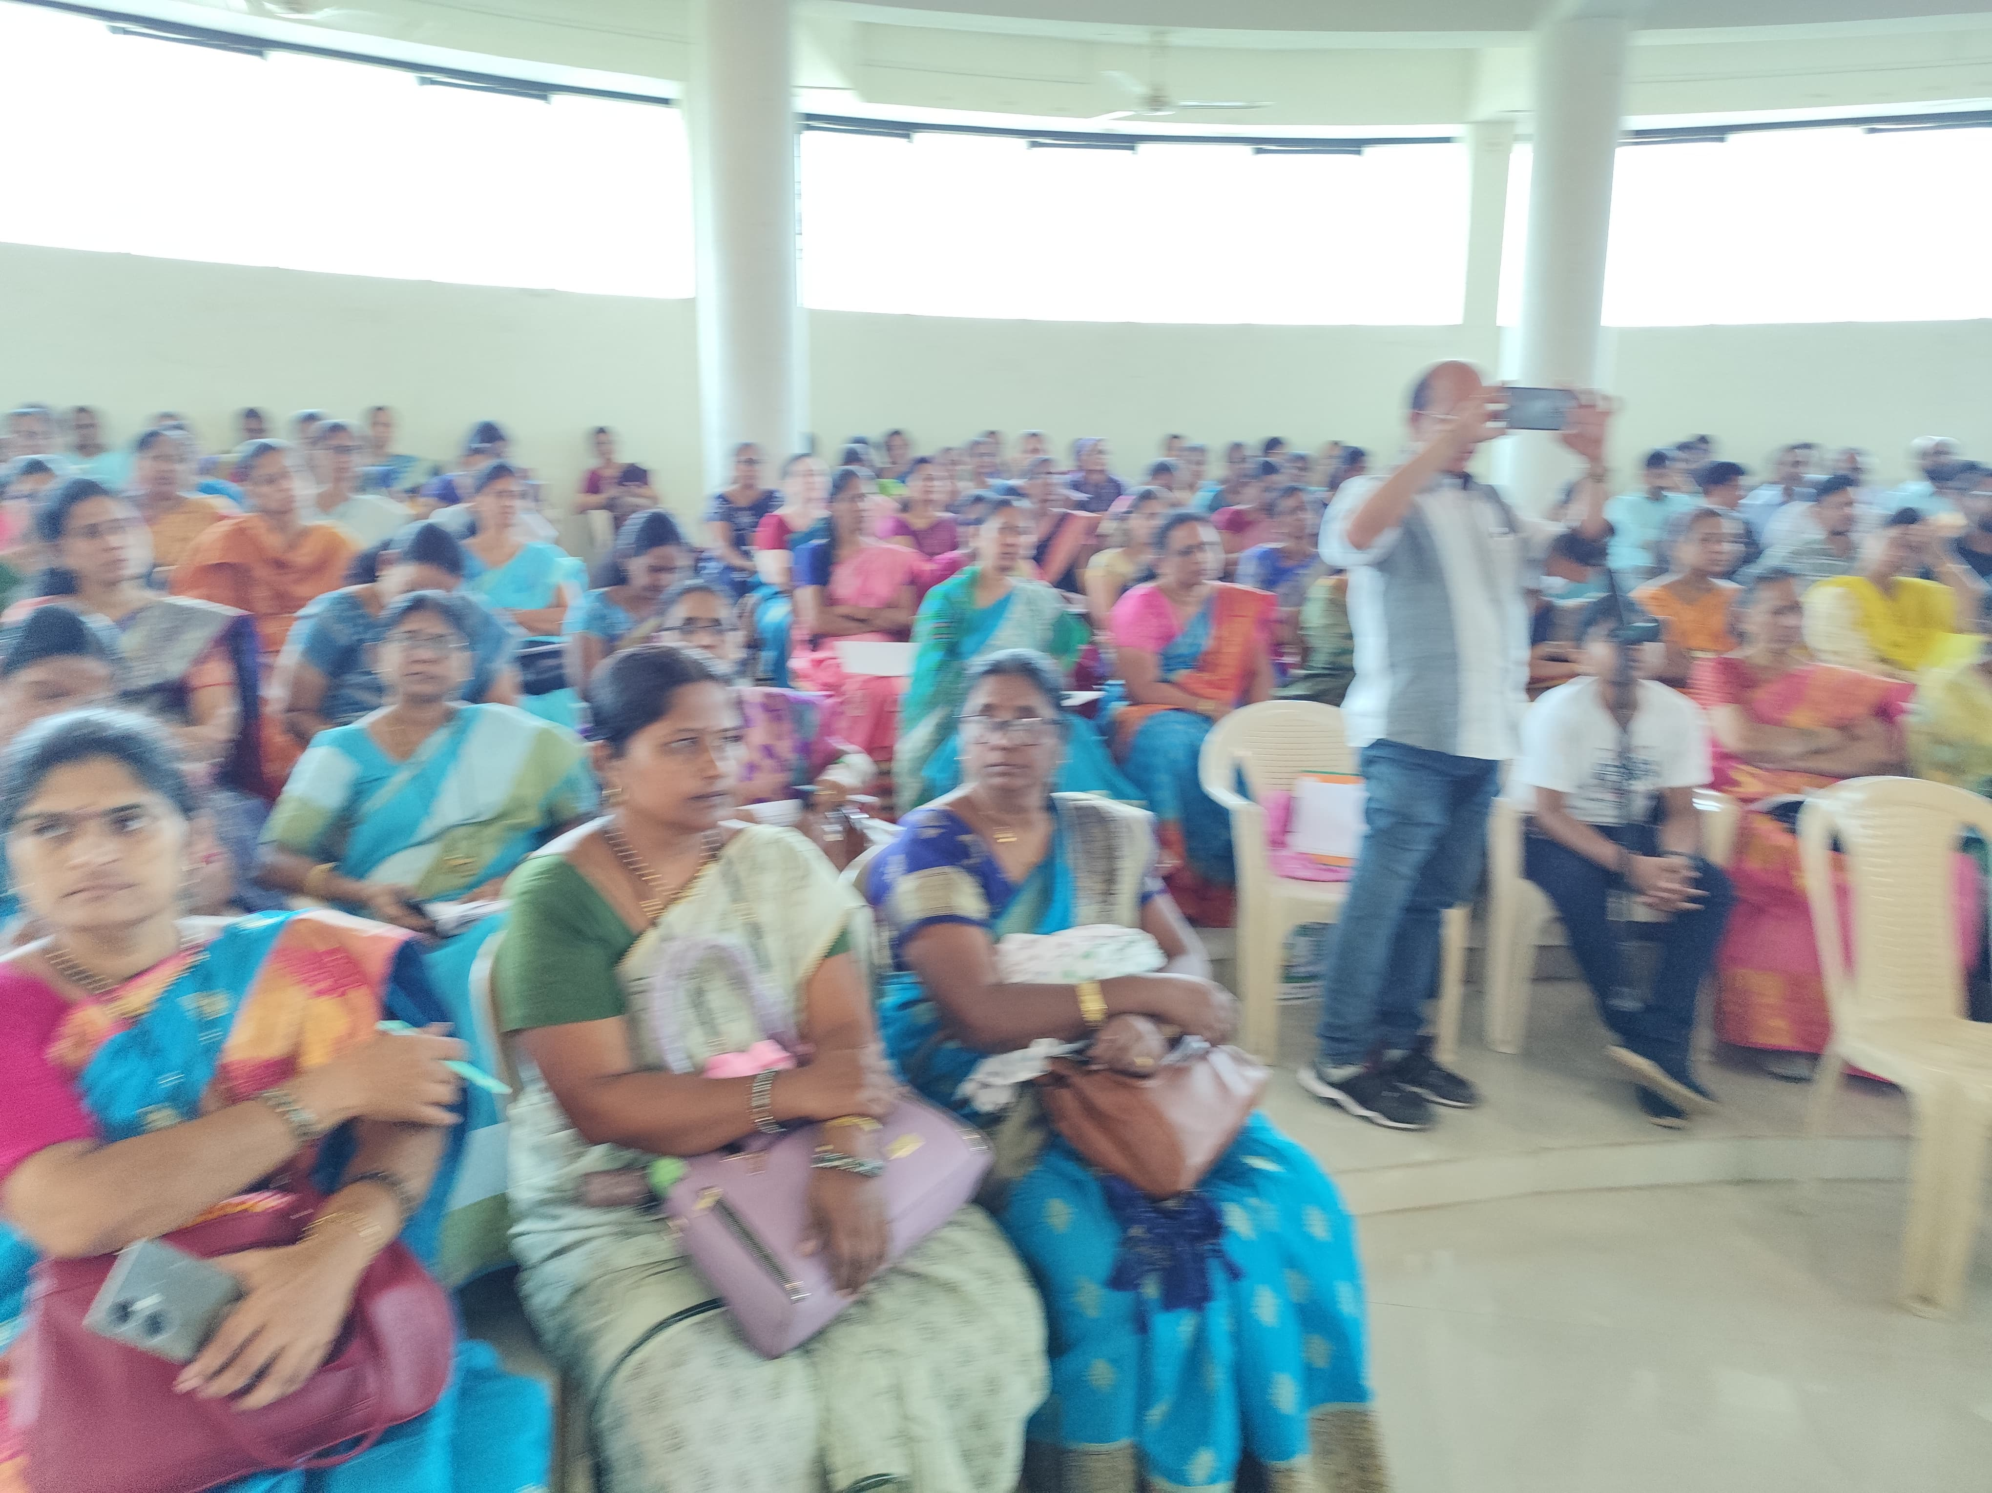
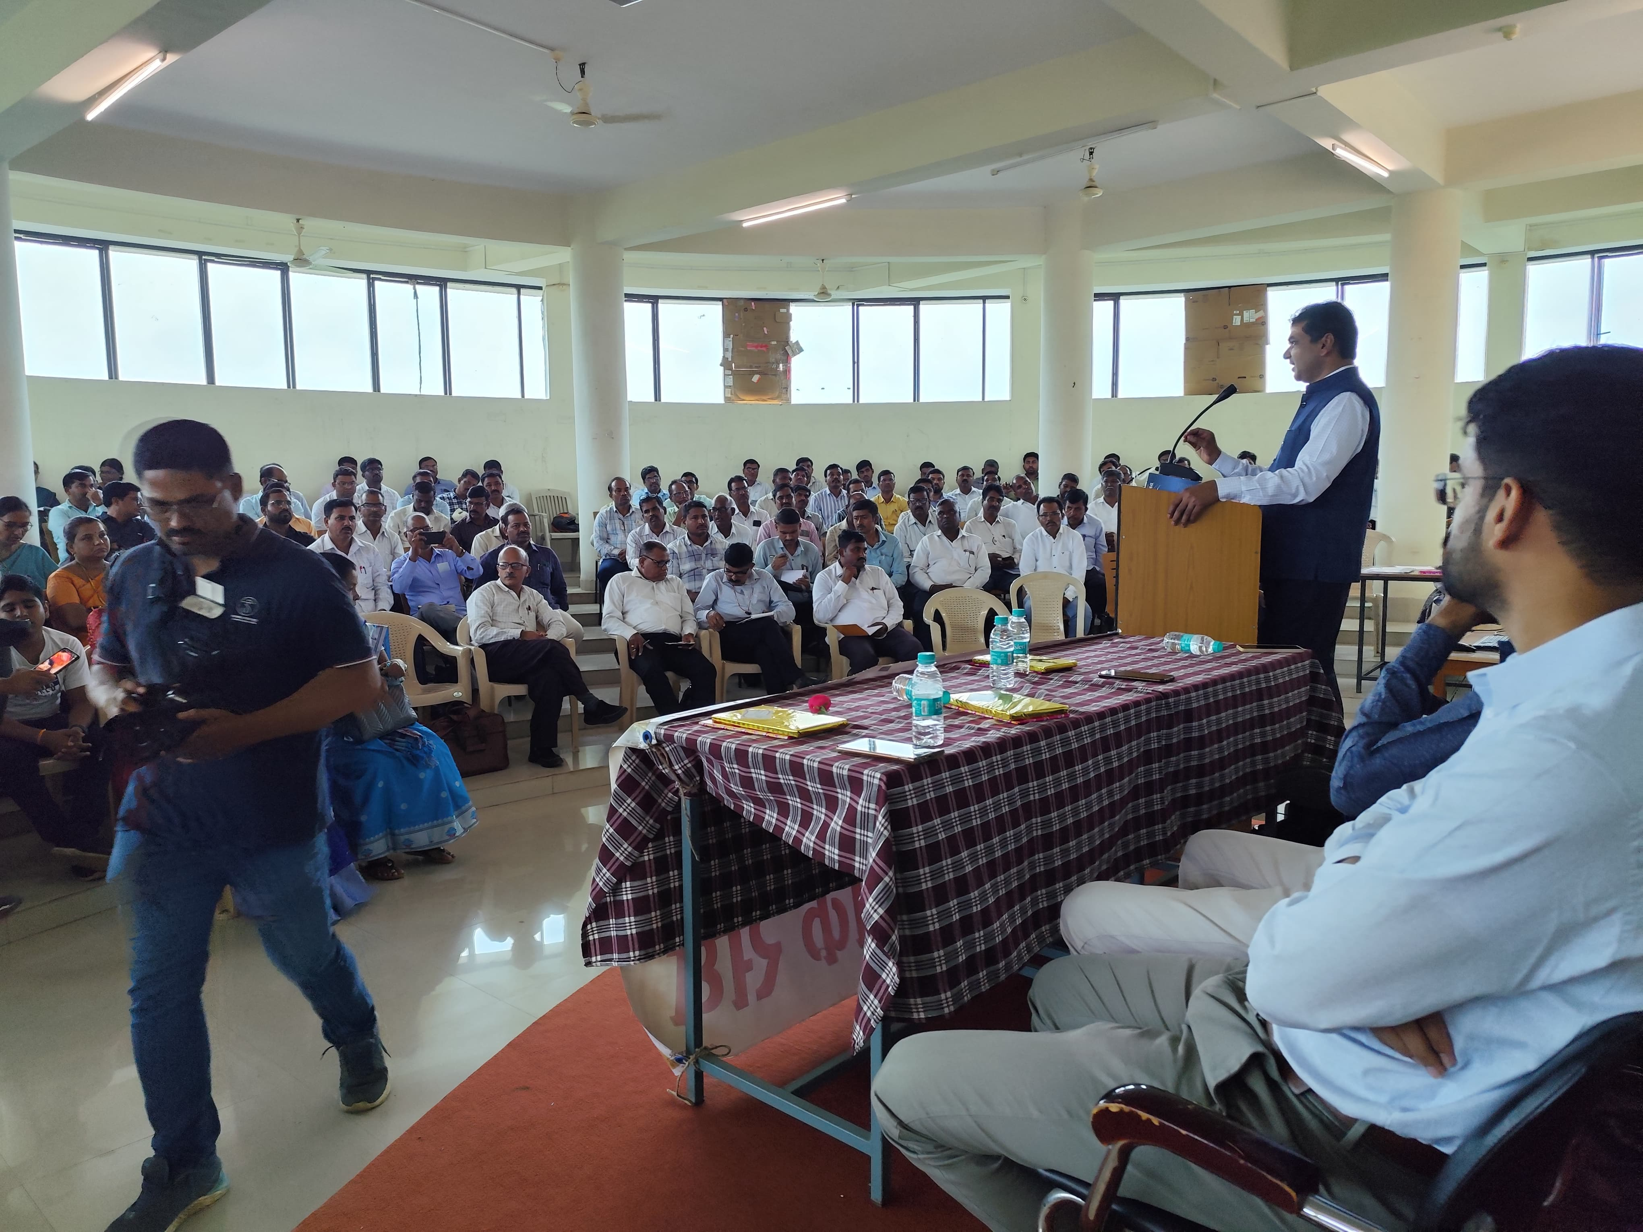
Workshop for Teachers : organized on 09.10.2024
The Workshop for Teachers was held by RSIAC, Satara in collaborated with Satara District Teachers Sangh, Satara.
"The workshop also focused on new methods of education, aiming to introduce innovative teaching techniques and learning approaches.
140 Teachers participated from different school of this event.

Slide 20
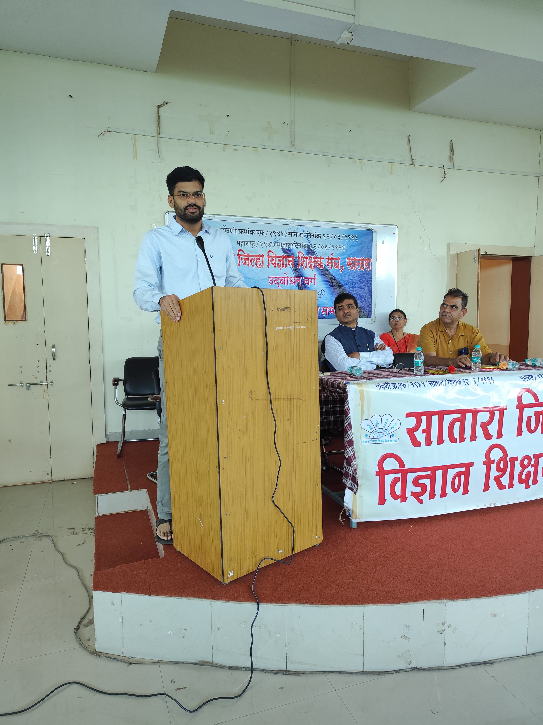
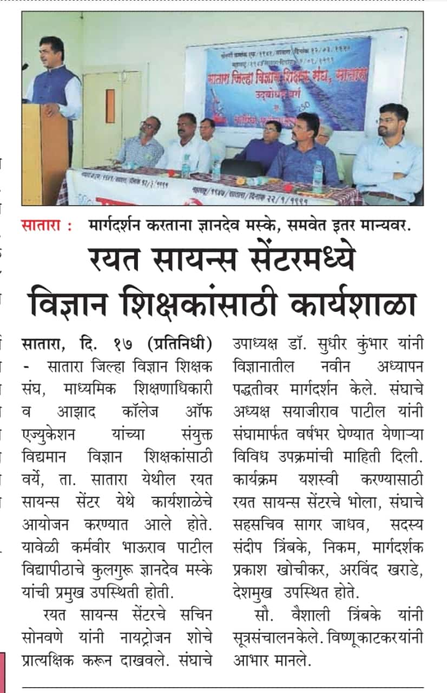
Workshop for Teachers : 9.10.2024

Slide 21
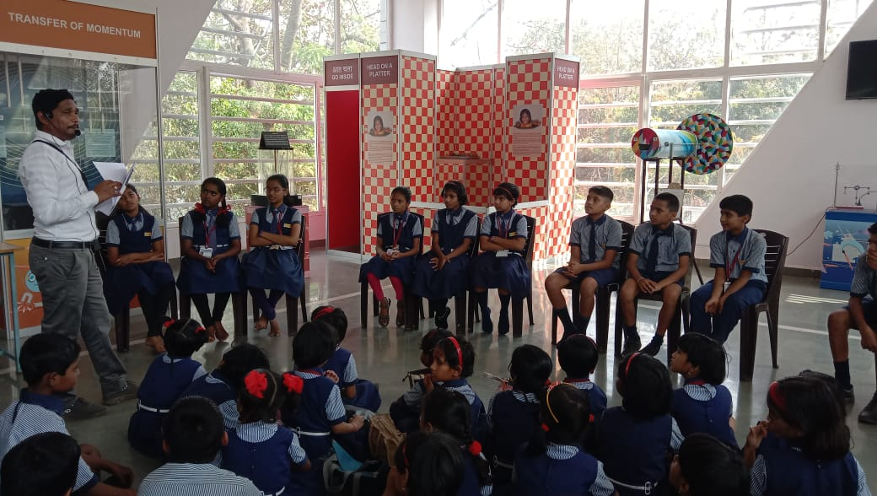



Competition : Quiz and Slogan Competition conducted on 07.10.2024
Quiz Competition
Slogan Writing Competition

Slide 22




Competition : Drawing Competition, Rangoli Competition and Group Discussion held on 28.02.2025
Drawing Competition
Group Discussion
Rangoli Competition

Slide 23



Visit of Dignitaries
ZP Education Officer Satara on 09.10.2024
Rayat Shikshan Sanstha’s Hon'ble Chairmen and Secretoary
On 14.09.2024
ISRO Jr. Scientist Dr. Shirish Ravan
Dipsthambh Charitable Trust, Arthasahayy Foundation Members. On 01.08.2024

Slide 24
Future Plans
Short Run Plans
Long Run Plans
Changes in Exhibition Gallery
Exhibition of Rocks and Fossils
Procuring the Telescopes
MoUs with schools in vicinity
Increase outreach programs.
Designing the summer and winter camps for students
Designing science based short term courses.
Designing the FDP based on science themes like AI, Robotics etc.
Procuring Tarangan
Construction of 1st floor
Auditorium 3D for showcasing planetarium
AI and Robotics Laboratory
Science on Wheels

Slide 25
Thank You
Rayat Science And Innovation Activity Centre, Varye , Satara.
Email id : rsiacvarye@gmail.com
Contact No. : 9822124414 / 8605145013

